Slide 1
Western Regional Science Association
64th Annual Meeting
Hilton Lake Las Vegas
Feb 12th – 15th, 2025
Exploring Regenerative Urban Development in Europe:
Data Envelopment Analysis of City Smartness
Authors: Ivana Marjanović*, Jelena Stanković, Marija Džunić, Marina Stanojević, Saša Čegar
*ivana.veselinovic@eknfak.ni.ac.rs
This research is part of the 101059994 – UR-DATA - HORIZON-WIDERA-2021-ACCESS-02 project, funded by the European Union. Views and opinions expressed are however those of the authors only and do not necessarily reflect those of the European Union or the European Research Executive Agency. Neither the European Union nor the European Research Executive Agency can be held responsible for them.

Slide 2
Introduction
Urbanization has transformed cities into engines of economic activity and innovation while introducing significant challenges, including resource inefficiency, environmental degradation, and social inequality.
Addressing these issues requires resilient urban systems capable of adapting to socio-economic and environmental disruptions
The concept of resilience and regenerative development have gained prominence as a critical framework for urban development
Urban resilience, defined as the capacity of cities to absorb, recover, and adapt to shocks and stresses, has emerged as a pivotal concept in regional planning (Lehmann, 2018).
Regenerative urban development represents a forward-thinking approach that transcends traditional sustainable practices by focusing on restoring and enhancing urban systems' ecological, social, and economic capacities
Regenerative urban development emphasizes participatory governance, innovative infrastructure, and adaptive strategies that enable cities to thrive while addressing environmental degradation and social inequities

Slide 3
Introduction
The concept of urban resilience intersects with frameworks such as smart cities, which integrate technology, governance, and community engagement to address urban challenges.
The main objective of the research: to evaluate the efficiency of European smart cities through the lens of urban resilience and regenerative development
It emphasizes the role of benchmarking as a tool to inform resilience policies and regional development strategies.
By quantitatively assessing various dimensions of urban smartness, benchmarking enables local governments to make informed decisions and prioritize resources effectively.
Methodology: Data Envelopment Analysis (DEA)
Data: a sample of 80 European cities
Source: Eurostat Urban Audit Perception Survey

Slide 4
Research methodology and data
DEA is a non-parametric, deterministic model initially developed as a benchmarking tool in production economics to assess relative efficiency (Deilmann et al., 2016).
Over the past decades, the application of DEA has expanded significantly, encompassing uses in the construction of composite indices. When it comes to constructing composite indices, DEA gained prominence through the work of Cherchye and associates (2007). This methodology, known as the Benefit-of-the-Doubt (BoD) composite index construction, corresponds to an input-oriented DEA model with an assumption of constant returns to scale (Szuwarzyński, 2019).
The Benefit of the Doubt (BoD) approach facilitates benchmarking, where the best-performing entities establish the 'best practice frontier’.
This assumes that all factors in the model are outputs. In this scenario, the outputs, serving as performance metrics, must satisfy the condition of 'the more, the better' (Cook et al., 2014).
The input-oriented maximization problem under constant returns to scale for each evaluated unit $k$ can be expressed in linear form as follows (Szuwarzyński, 2019):
$${CI}_{k}=\max_{w_{ik}}{\sum_{i=1}^{m}{w_{ik}y_{ik}}}$$
s.t.
$$\sum_{i=1}^{m}{w_{ik}y_{ij}≤1, j=1,…,n, j≠k}$$
$$w_{ik}≥0, i=1,…,m$$

Slide 5
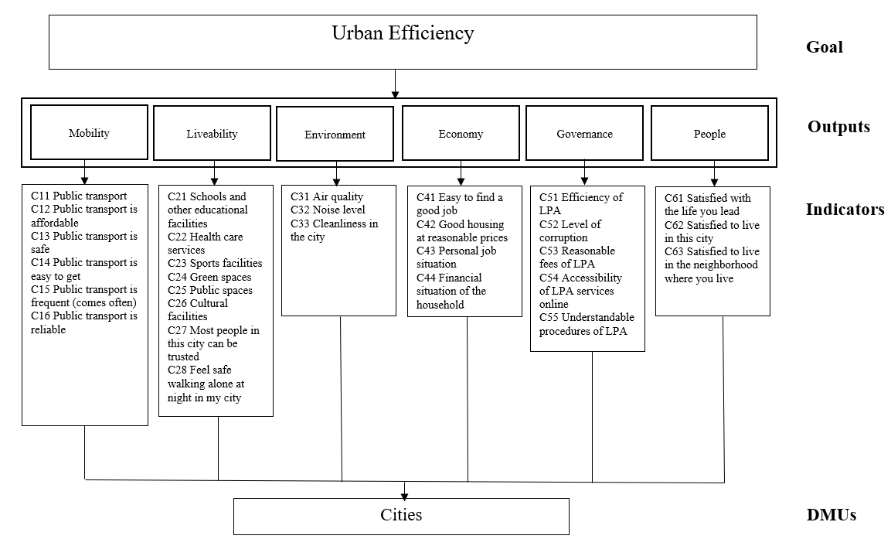
Research methodology and data
This study adopts Giffinger et al.’s (2007) framework of smart city dimensions as a basis for assessing urban efficiency.
The six dimensions of smart cities —mobility, liveability, environment, economy, governance, and people —align closely with resilience principles
By incorporating a regional development perspective, the analysis highlights how city-level initiatives contribute to broader resilience and sustainability goals.

Slide 6
Research methodology and data
The data within each dimension was aggregated using the Simple Additive Weighting (SAW) method, with equal weights assigned to all indicators.
 | N | Minimum | Maximum | Mean | Std. Deviation
Mobility | 80 | .59 | .98 | .8417 | .06894
Liveability | 80 | .67 | .98 | .8524 | .06543
Economy | 80 | .71 | .97 | .8241 | .05286
Environment | 80 | .59 | .97 | .8161 | .09103
Governance | 80 | .68 | .92 | .8215 | .04537
People | 80 | .74 | 1.00 | .8943 | .05382
Valid N (listwise) | 80
Citizens in the observed cities rate their quality of life, as reflected by the people dimension, the highest, with an average score of 0.8943 out of 1. They also express considerable satisfaction with the liveability dimension, which has an average score of 0.8524. However, the environment dimension is identified as the most significant challenge, with the lowest average score of 0.8161 in the observed sample.

Slide 7
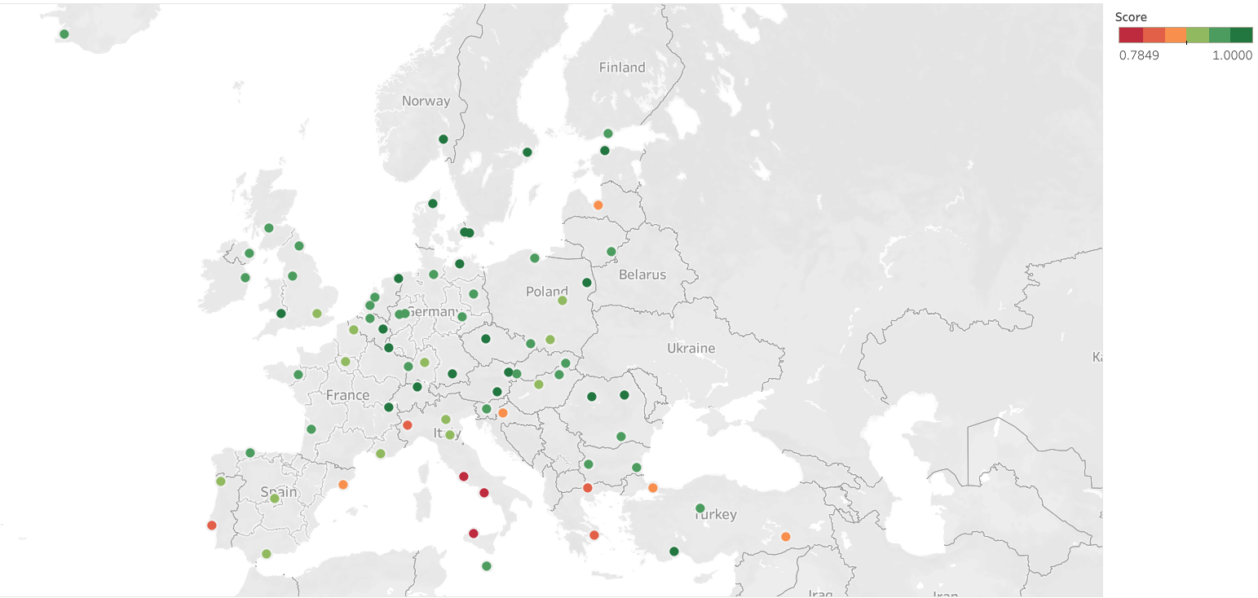
Results
City | Score | Rank | City | Score | Rank
Aalborg | 100.00% | 1 | Essen | 94.47% | 41
Luxembourg | 100.00% | 1 | Burgas | 94.33% | 42
Cluj-Napoca | 100.00% | 1 | Brussel | 94.23% | 43
Zurich | 100.00% | 1 | Nicosia | 94.21% | 44
Groningen | 99.24% | 5 | Bucharest | 94.17% | 45
Geneve | 98.46% | 6 | Dortmund | 94.12% | 46
Graz | 98.18% | 7 | Strasbourg | 94.11% | 47
Copenhagen | 98.15% | 8 | Sofia | 93.90% | 48
Antalya | 98.13% | 9 | Miskolc | 93.87% | 49
Prague | 98.02% | 10 | Glasgow | 93.82% | 50
Oslo | 97.96% | 11 | Amsterdam | 93.77% | 51
Bialystok | 97.69% | 12 | Košice | 93.75% | 52
Vienna | 97.12% | 13 | Bratislava | 93.34% | 53
Tallinn | 96.96% | 14 | Berlin | 93.01% | 54
Oulu | 96.90% | 15 | Bordeaux | 92.86% | 55
Cardiff | 96.79% | 16 | Warsaw | 92.23% | 56
Rostock | 96.71% | 17 | London | 92.16% | 57
Liege | 96.65% | 18 | Budapest | 92.07% | 58
Munich | 96.58% | 19 | Stuttgart | 91.47% | 59
Stockholm | 96.54% | 20 | Krakow | 91.40% | 60
Piatra Neamt | 96.43% | 21 | Braga | 91.03% | 61
Malmö | 96.43% | 21 | Marseille | 90.85% | 62
Leipzig | 96.20% | 23 | Málaga | 90.67% | 63
Valletta | 96.16% | 24 | Lille | 90.63% | 64
Reykjavik | 96.16% | 24 | Paris | 90.62% | 65
Antwerp | 95.93% | 26 | Verona | 89.84% | 66
Gdansk | 95.81% | 27 | Bologna | 89.79% | 67
Belfast | 95.80% | 28 | Madrid | 89.67% | 68
Ankara | 95.78% | 29 | Riga | 88.76% | 69
Manchester | 95.69% | 30 | Barcelona | 88.42% | 70
Rennes | 95.39% | 31 | Diyarbakir | 88.35% | 71
Helsinki | 95.33% | 32 | Zagreb | 88.17% | 72
Newcastle upon Tyne | 95.19% | 33 | Istanbul | 87.02% | 73
Ljubljana | 95.14% | 34 | Lisbon | 85.32% | 74
Ostrava | 94.95% | 35 | Heraklion | 84.10% | 75
Hamburg | 94.91% | 36 | Turin | 84.03% | 76
Dublin | 94.86% | 37 | Athens | 82.41% | 77
Vilnius | 94.74% | 38 | Rome | 80.15% | 78
Oviedo | 94.58% | 39 | Naples | 79.74% | 79
Rotterdam | 94.48% | 40 | Palermo | 78.49% | 80
Southern Europe tend to exhibit lower levels of urban efficiency compared to their counterparts in other regions

Slide 8
Discussion
Many cities in Southern Europe have aging infrastructure that may not align with modern efficiency standards.
Historical urban layouts in cities like Rome and Athens, while culturally significant, often lack the adaptability required for smart city transformations.
Nevertheless, by identifying specific areas for improvement, cities can prioritize investments in infrastructure, technology, and governance to enhance their overall efficiency.
Wang et al. (2020b) stressed the importance of aligning policy objectives with measurable outcomes to achieve regenerative urban development.
The findings highlight the importance of tailored policy interventions to address city-specific challenges. For example, cities with low mobility scores can benefit from investments in public transportation and non-motorized transport options.

Slide 9
Discussion
The findings underscore the need for integrated urban and regional planning. In order to achieve better efficiency performance, policymakers should prioritize:
Data-Driven Governance: Utilizing analytics to monitor urban performance and guide resource allocation. For example, Zurich’s use of data to align urban mobility with environmental goals exemplifies effective data integration.
Collaborative Frameworks: Fostering partnerships among public, private, and community stakeholders. Luxembourg’s emphasis on public-private collaborations has enabled innovative solutions in energy and housing.
Sustainability-Oriented Investments: Promoting initiatives that deliver long-term social and environmental benefits. Cities with extensive green infrastructure, such as Aalborg, demonstrate how such investments can enhance liveability and resilience.
As a benchmark for resilience, Zurich exemplifies urban efficiency through cohesive planning, citizen-centric policies, and advanced mobility systems. Its public transport network integrates trams, buses, and trains, reducing congestion and environmental impact. Transparent governance ensures alignment with resident needs, while green initiatives, such as renewable energy and urban green spaces, reinforce resilience (Menendez & Ambühl, 2022; Perić et al., 2023).

Slide 10
Conclusion
Smart city initiatives offer significant potential to enhance urban and regional resilience.
By benchmarking their efficiency, this study provides a diagnostic tool for identifying strengths and weaknesses in urban systems.
The findings emphasize the importance of adaptive, inclusive, and sustainability-oriented strategies for regenerative development.
By integrating technological advancements, governance reforms, and community engagement, cities can create systems capable of addressing current and future challenges.
This approach not only strengthens urban areas but also contributes to broader regional development, ensuring sustainable and equitable growth.
Future research should incorporate longitudinal data to capture trends and refine resilience strategies.

Slide 11
Western Regional Science Association
64th Annual Meeting
Hilton Lake Las Vegas
Feb 12th – 15th, 2025
Exploring Regenerative Urban Development in Europe:
Data Envelopment Analysis of City Smartness
Authors: Ivana Marjanović*, Jelena Stanković, Marija Džunić, Marina Stanojević, Saša Čegar
*ivana.veselinovic@eknfak.ni.ac.rs
This research is part of the 101059994 – UR-DATA - HORIZON-WIDERA-2021-ACCESS-02 project, funded by the European Union. Views and opinions expressed are however those of the authors only and do not necessarily reflect those of the European Union or the European Research Executive Agency. Neither the European Union nor the European Research Executive Agency can be held responsible for them.

