Slide 1
2024 NECTAR Conference Vrije Universiteit Brussel, Brussels, Belgium
July 3-5, 2024
Cluster 4 –The role of urban mobility transitions in sustainable futures (CL4.2)
Data-Driven Solutions for Urban Transport Challenges in Developing Cities
John Östh, Jelena J. Stanković, Ivana Marjanović, Umut Turk, Zvonko R. Milošević

Slide 2
Introduction to Data-Driven Urban Mobility
Urbanization and Mobility Challenges: Increasing urbanization brings significant challenges to city planning, particularly in arranging sustainable mobility.
Importance of Data-Driven Approaches: Digital services and data-driven methods are integral for optimizing transport and improving customer experience.
Source:
Lahti, J., Heino, I., & Lusikka, T. (2023). The Concept of Urban Mobility Innovation Environment for Data-Driven Service Development. Transportation Research Procedia, 72, 1792-1799. doi:10.1016/j.trpro.2023.11.655
Notes:
Alessandro Lue, Marta Galliani, Simona Muratori, Paola Tresca -POLIEDRA
Daniela Molinari, Politecnico
Claudia Hedwig Yamu, Zacharias Andreakis, John Osth -OSLOMET

Slide 3
Evolution of Data Sources for Urban Mobility
Conventional vs. Emerging Data Sources: Traditional data sources include traffic sensors and cameras, while emerging sources involve crowdsourcing and mobile network data .
Case Study – Rijeka: Implementation of a prototype system utilizing crowdsourced and mobile network data for traffic management.
Source:
Urbanek, A. (2019). Data-driven transport policy in cities: A literature review and implications for future developments. In Integration as Solution for Advanced Smart Urban Transport Systems: 15th Scientific and Technical Conference “Transport Systems. Theory & Practice 2018”, Selected Papers" (pp. 61-74). Springer International Publishing.
Lægran, J., Pitera, K., & Tørset, T. (2023). Carrier-provided freight data for improved sustainable urban mobility planning. Research in Transportation Economics, 102, 101352.
Notes:
Alessandro Lue, Marta Galliani, Simona Muratori, Paola Tresca -POLIEDRA
Daniela Molinari, Politecnico
Claudia Hedwig Yamu, Zacharias Andreakis, John Osth -OSLOMET

Slide 4
Methodologies in Urban Mobility Analysis
Graph-Based Mobility Networks: Individual travel motifs are abstracted into graph-based models to form global and motif-dependent urban mobility networks
Characterization of Mobility Networks: Statistical measures and scaling relations are used to characterize urban mobility networks, revealing patterns and spatial heterogeneities .
Source:
Cao, J., Li, Q., Tu, W., Gao, Q., Cao, R., & Zhong, C. (2021). Resolving urban mobility networks from individual travel graphs using massive-scale mobile phone tracking data. Cities, 110, 103077.
Notes:
Alessandro Lue, Marta Galliani, Simona Muratori, Paola Tresca -POLIEDRA
Daniela Molinari, Politecnico
Claudia Hedwig Yamu, Zacharias Andreakis, John Osth -OSLOMET

Slide 5
Data-Driven Service Development
Living Labs for Innovation: Provider-driven living labs are used to co-develop new transport services and solutions. Example: Tampere Urban Rail Mobility Services (TURMS) living lab.
Technical Requirements for Data Ecosystems: Essential requirements include data ecosystem support, operational support, and technology development support for long-term projects.
Source:
Lahti, J., Heino, I., & Lusikka, T. (2023). The Concept of Urban Mobility Innovation Environment for Data-Driven Service Development. Transportation Research Procedia, 72, 1792-1799. doi:10.1016/j.trpro.2023.11.655​
Notes:
Alessandro Lue, Marta Galliani, Simona Muratori, Paola Tresca -POLIEDRA
Daniela Molinari, Politecnico
Claudia Hedwig Yamu, Zacharias Andreakis, John Osth -OSLOMET

Slide 6
Case Studies and Applications
Shenzhen, China: Analysis of massive-scale mobile phone tracking data to understand urban mobility patterns and inform urban planning policies.
Helsinki, Finland: Use of electric buses as living labs to collect data and develop public transport solutions.
Source:
Zhang, L., Chen, P., & Hui, F. (2022). Refining the accessibility evaluation of urban green spaces with multiple sources of mobility data: A case study in Shenzhen, China. Urban Forestry & Urban Greening, 70, 127550.
Ghaffarpasand, O., & Pope, F. D. (2024). Telematics data for geospatial and temporal mapping of urban mobility: New insights into travel characteristics and vehicle specific power. Journal of Transport Geography, 115, 103815.
Notes:
Alessandro Lue, Marta Galliani, Simona Muratori, Paola Tresca -POLIEDRA
Daniela Molinari, Politecnico
Claudia Hedwig Yamu, Zacharias Andreakis, John Osth -OSLOMET

Slide 7
Challenges and Considerations
Privacy and Data Anonymization: Ensuring privacy and addressing concerns related to data sharing and anonymization.
Data Standardization and Integration: Challenges in standardizing and integrating diverse data sources for comprehensive analysis​​.
Source: He, L., Li, W., Li, J., & Sun, J. (2024). Urban mobility analytics amid COVID-19 pandemic: A framework for promoting work resumption based on mobile phone data. Journal of Transport Geography, 117, 103887.
Lægran, J., Pitera, K., & Tørset, T. (2023). Carrier-provided freight data for improved sustainable urban mobility planning. Research in Transportation Economics, 102, 101352.
Notes:
Alessandro Lue, Marta Galliani, Simona Muratori, Paola Tresca -POLIEDRA
Daniela Molinari, Politecnico
Claudia Hedwig Yamu, Zacharias Andreakis, John Osth -OSLOMET

Slide 8
Key points to implement in the research of City of Niš
The role of diverse data sources in enhancing urban mobility management.
Methodologies for analyzing urban mobility networks using complex data sets.
Replicate the examples of living labs and real-world applications (the study of Uppsala)
Addressing challenges related to privacy, data standardization, and long-term project support.
The importance of data-driven policies for sustainable urban development.
Source: Urbanek, A. (2019). Data-driven transport policy in cities: A literature review and implications for future developments. In Integration as Solution for Advanced Smart Urban Transport Systems: 15th Scientific and Technical Conference “Transport Systems. Theory & Practice 2018”, Selected Papers" (pp. 61-74). Springer International Publishing.
Lægran, J., Pitera, K., & Tørset, T. (2023). Carrier-provided freight data for improved sustainable urban mobility planning. Research in Transportation Economics, 102, 101352.
Notes:
Alessandro Lue, Marta Galliani, Simona Muratori, Paola Tresca -POLIEDRA
Daniela Molinari, Politecnico
Claudia Hedwig Yamu, Zacharias Andreakis, John Osth -OSLOMET

Slide 9
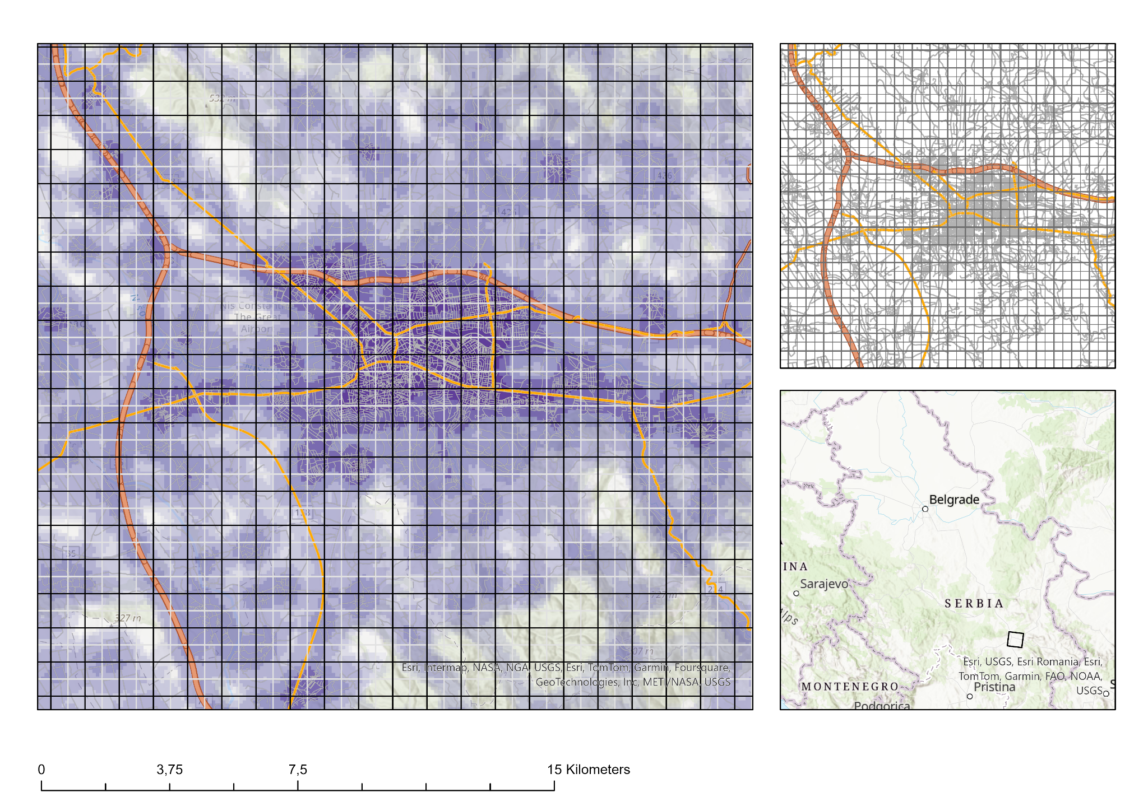
The case study for the City of Niš
Left:
Map showing gridded units (1 km in black and 500m in white) overlayed over Nis.
Grids can be associated with demographic characteristics and economic activities
Purple colours indicate density of roads (here proxying urban concentration)
Right:
Zoom out on the city region
Depicting Nis in Serbia
Notes:
Alessandro Lue, Marta Galliani, Simona Muratori, Paola Tresca -POLIEDRA
Daniela Molinari, Politecnico
Claudia Hedwig Yamu, Zacharias Andreakis, John Osth -OSLOMET

Slide 10
Future Directions
Policy Implications: Using data-driven insights to inform urban planning and policy-making, ensuring sustainable urban development​.
Technological Advancements: Leveraging advancements in ICT and smart devices to enhance urban mobility management systems.
Examples on next slides
Notes:
Alessandro Lue, Marta Galliani, Simona Muratori, Paola Tresca -POLIEDRA
Daniela Molinari, Politecnico
Claudia Hedwig Yamu, Zacharias Andreakis, John Osth -OSLOMET

Slide 11
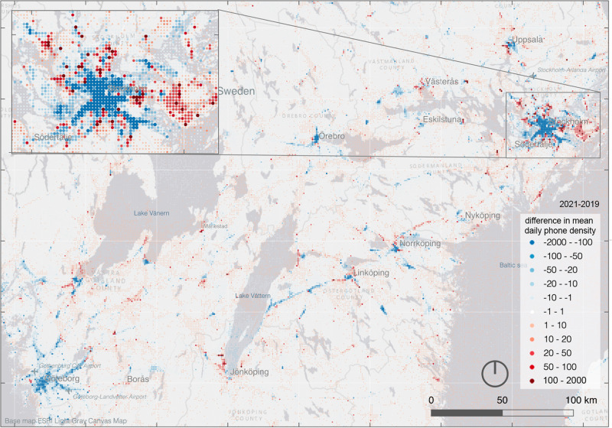
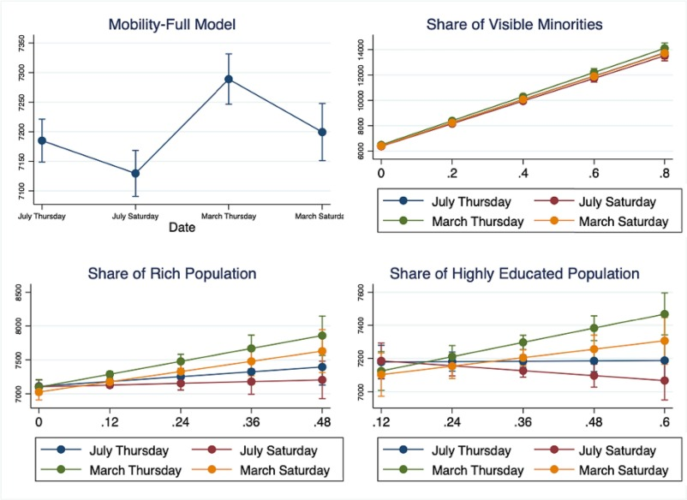
Future Directions
Over time comparison:
A: Change in daily commuting distance during the pandemic
B: Social effects and pandemic
C: First differencing of changes over time (what areas increase/decrease)
A
C
B
Shuttleworth, I., Toger, M., Türk, U., & Östh, J. (2024). Did liberal lockdown policies change spatial behaviour in Sweden? Mapping daily mobilities in Stockholm using mobile phone data during COVID-19. Applied Spatial Analysis and Policy, 17(1), 345-369.
Toger, M., Türk, U., Östh, J., Kourtit, K., & Nijkamp, P. (2023). Inequality in leisure mobility: An analysis of activity space segregation spectra in the Stockholm conurbation. Journal of transport geography, 111, 103638.
Östh, J., Toger, M., Türk, U., Kourtit, K., & Nijkamp, P. (2023). Leisure mobility changes during the COVID-19 pandemic–An analysis of survey and mobile phone data in Sweden. Research in Transportation Business & Management, 48, 100952.
Notes:
Alessandro Lue, Marta Galliani, Simona Muratori, Paola Tresca -POLIEDRA
Daniela Molinari, Politecnico
Claudia Hedwig Yamu, Zacharias Andreakis, John Osth -OSLOMET

Slide 12
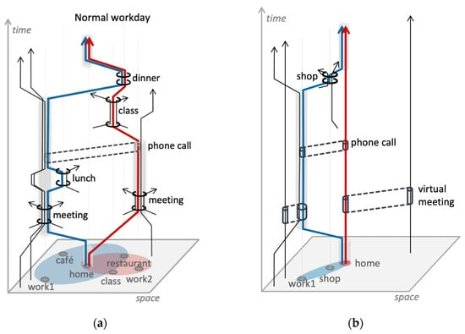
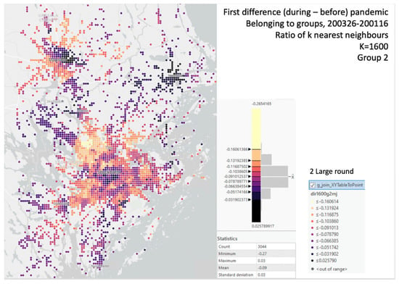
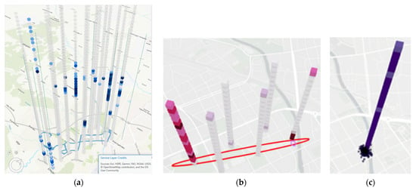
Future Directions
A
Individual mobility
A: Space-time depictions of individual mobility during COVID
B: Factual prisms during COVID
C: STD ellipse /Radius of gyration from
Individual mobility
D: changes in frequency of C in different
areas
D
B
C
Notes:
Alessandro Lue, Marta Galliani, Simona Muratori, Paola Tresca -POLIEDRA
Daniela Molinari, Politecnico
Claudia Hedwig Yamu, Zacharias Andreakis, John Osth -OSLOMET

Slide 13
Future Directions…
Ambient population studies
Risk analysis, emergency response
Economic performance – localization support
Transport optimization
Potential for PT development
Bottleneck or vulnerability indicator

