Slide 1
33rd European Conference on Operational Research
30th June – 3rd July 2024
Technical University of Denmark (DTU), Copenhagen, Denmark
Measuring Urban Smartness: A Comparative Study of European Cities Using Multi-Criteria Analysis
Authors: Sandra Milanović, Jelena J. Stanković, Ivana Marjanović*,
*ivana.veselinovic@eknfak.ni.ac.rs
This research is part of the 101059994 – UR-DATA - HORIZON-WIDERA-2021-ACCESS-02 project, funded by the European Union. Views and opinions expressed are however those of the authors only and do not necessarily reflect those of the European Union or the European Research Executive Agency. Neither the European Union nor the European Research Executive Agency can be held responsible for them.

Slide 2
Introduction
The prevailing and anticipated rates of urbanization are recognized as substantial challenges to the society.
Cities need to become more sustainable and self-sufficient in order to provide quality life for their citizens.
By 2050:
more than 60% of the world’s population will live in an urban area
Europe – share of the population living in urban areas will rise to just over 80%
Urban areas have been recognized as primary drivers of economic development, however, the rapid expansion of cities in recent decades has raised concerns regarding their sustainability, as evidenced by escalating infrastructural, ecological, and social challenges
To analyze the diverse attributes of cities' urban performance, a multi-criteria model is developed
Methodology: PROMETHEE
Data: a sample of 80 European cities
Source: Eurostat Urban Audit Perception Survey

Slide 3
Smart Cities Concept
Urbanization creates a number of economic and environmental problems: pollution, sanitation, ageing population, transport, inequality, safety issues and others
Response: cities should have smart infrastructure and the sustainable use of resources available in the immediate surroundings of cities
The development of the smart city concept included various aspects of urban development - economy, society, governance, environmental conditions and citizens’ satisfaction
The main benefits of smart cities: efficient resource allocation, improved security and the overall quality of life of urban dwellers.
Vienna Centre of Regional Science defines a Smart City as city well performing in a forward-looking way in these six characteristics (smart economy, smart people, smart governance, smart mobility, smart environment and smart living), built on the ‘smart’ combination of endowments and activities of self-decisive, independent and aware citizens
One of the ways for evaluating city’s smartness: assessment of citizens’ perceptions on various aspects of urban life

Slide 4
Research methodology and data
The aim of this study: to create composite index of urban smartness and compare cities in different European regions using 29 different indicators, grouped into six categories that cover various aspects of urban living.
A number of socioeconomic phenomena cannot be measured by a single descriptive indicator and they should be represented with multiple dimensions and measured by accounting the ‘combination’ of different dimensions
This combination can be obtained by creating composite indices:
Composite indicators are ‘based on sub-indicators that have no common meaningful unit of measurement and there is no obvious way of weighting these sub-indicators’ (Saisana & Tarantola 2002, p. 5);
Composite indicator ‘is formed when individual indicators are compiled into a single index, on the basis of an underlying model of the multi-dimensional concept that is being measured’ (Nardo et al. 2005, p. 8).
Building a composite index is a delicate task (weighting, aggregation).

Slide 5
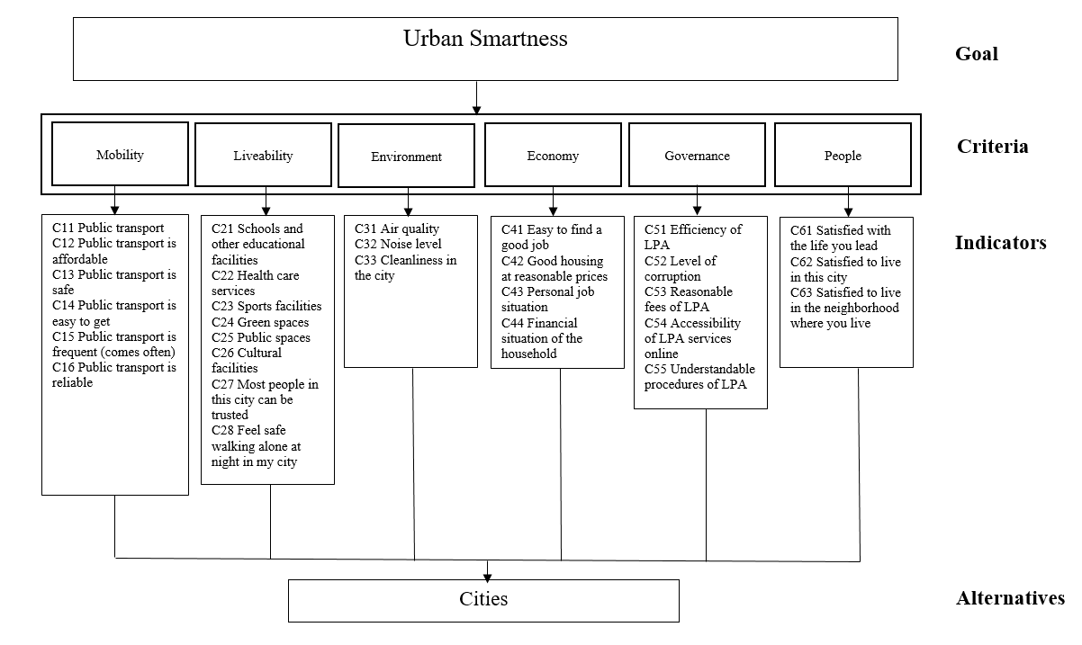
Research methodology and data

Slide 6
Research methodology and data
There are several possible methods for determining weight coefficients divided into two broad groups:
Subjective methods of determining weighting coefficients based on the subjective judgement of the decision-maker or expert on the importance of the criteria for a given decision problem
Objective methods that focus on the analysis of the decision matrix. These approaches use objective data, without interfering with the subjective judgments of the decision-maker.
To determine the weighting coefficients in this study, one of the methods of the objective approach was applied - the entropy method
There are several methods for indicators aggregation (linear aggregation, geometric aggregation and aggregation using MCDM)
The advantage of aggregation using the methods of multi-criteria analysis is that in this way non-compensatory or partially compensatory composite indices are obtained
In order to create a composite index, the PROMETHEE method was applied in this study
PROMETHEE methods will ensure that weights will act as ‘importance coefficients’ rather than trade-offs, contrary to other types of aggregation approaches

Slide 7
Results
Mobility | Livability | Environment | Economy | Governance | People
0.166648 | 0.166669 | 0.166706 | 0.166535 | 0.166727 | 0.166715

Slide 8
Conclusion
The development and implementation of a composite index represent a multifaceted process that involves several steps
Composite indices provide an irreplaceable contribution to simplification; however, they are based on methods that aggregate basic information and can lead to a short-sighted analysis of the phenomenon if the entire procedure of creating composite indices is not followed, with special emphasis on the need for adequate weighting and aggregation
The contribution of this study is reflected in the proposition of a new composite index for measuring urban smartness on the empirical example of the European cities
The proposed composite index covers a large number of aspects of the smart city concept and can have both theoretical and practical implications.
From the theoretical aspect, a novel methodology for measuring the urban smartness has been developed indicating the possibilities and advantages of applying the methods of multi-criteria analysis in this area
From a practical standpoint, the proposed index can provide guidelines to policymakers when making strategic decisions aimed at further directions of urban/regional development

Slide 9
33rd European Conference on Operational Research
30th June – 3rd July 2024
Technical University of Denmark (DTU), Copenhagen, Denmark
Measuring Urban Smartness: A Comparative Study of European Cities Using Multi-Criteria Analysis
Authors: Sandra Milanović, Jelena J. Stanković, Ivana Marjanović*,
*ivana.veselinovic@eknfak.ni.ac.rs
This research is part of the 101059994 – UR-DATA - HORIZON-WIDERA-2021-ACCESS-02 project, funded by the European Union. Views and opinions expressed are however those of the authors only and do not necessarily reflect those of the European Union or the European Research Executive Agency. Neither the European Union nor the European Research Executive Agency can be held responsible for them.

