Slide 1
Cityphilia and Cityphobia: A multi-scalar search for urban happiness in Flanders
Peter Nijkamp
Karima Kourtit, Bart Neuts and Mia Wahlström

Slide 2
Study rationale
While more than half of the world population lives in urban areas, there is somewhat of a ‘hate-love’ relationship with the city: Complaints about inferior urban liveability and socioeconomic quality gap are offset by an appreciation of an urban way of life
Besides directly influencing inhabitants, cities are also linked to other cities and surrounding rural areas
This presentation analyses determinants of so-called ‘city love’ while accounting for spatial interconnectedness in a wider urban-rural network of satisfaction-drivers

Slide 3
Tiebout (1956): ‘voting by feet’
Optimal provision of public goods is of great importance
a big discrepancy between a local public good constituency
supply of local public goods takes place through a basket of amenities which are not necessarily individualised (e.g. located in their direct environment)
Permanent tension between ‘cityphilia’ and ‘cityphobia’ of citizens
Hypothesis: City love – as a quantitative measure for the citizens’ attachment to urban attractiveness - is shaped by both the body and the soul of the city in relation to its surrounding spatial system.

Slide 4
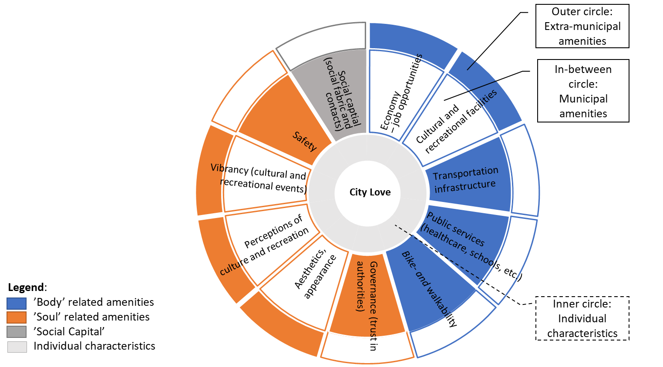
The ‘city love’ concept
Both subjective (survey) data and objective (register) data used in operationalization
Outer layers of the circle indicate that amenities can also be enjoyed outside of own city/municipality
Notes:
Figure 1 outlines the operationalisation of the conceptual model. City love is assessed through the residents’ perceived pride for and satisfaction with the municipality. The ‘body’ is evaluated through quantitative information on local economic conditions, commercial and public services, and transport infrastructure, while the ‘soul’ is assessed through measurable perceptions about culture and recreational facilities, trust in public authorities, safety and aesthetics. Social capital, finally, is estimated through perceptions on the citizens’ social contacts and fabric (see Figure 1).

Slide 5
Research data & methods
Case study of 300 Flemish municipalities. Region characterized by mostly smaller administrative areas (average size +/- 45 km², average population 22,143)
Tendency for rural or peri-urban living outside of city centres and commute for work or study, particularly to 13 “centre cities” + Brussels capital region
Data based on official statistical socio-economic data, as well as a large-scale survey with 139,470 respondents on perceptions of municipal resources and quality-of-life
Study used both standard OLS regression, OLS regression on logit-transformed data and Beta regression due to proportionality of survey data
Because of uncertain geographic context problem: investigation of spatial autocorrelation in a spatial dependence context
Notes:
Since survey-based data take the form of proportions (bound by zero to one values), standard assumptions of normally distributed error terms and constant variance tend to be violated
Furthermore, we will extent the model by testing for spatial autocorrelation in a spatial dependence context, since analysis on the level of municipal units falls into the uncertain geographic context problem: focusing purely on the own urban/rural unit can fail to account for important effects, since non-residential (extra-municipal) contexts such as the work and recreational environment can be important contributors to liveability and urban/rural satisfaction as well (Sørensen, 2014).

Slide 6
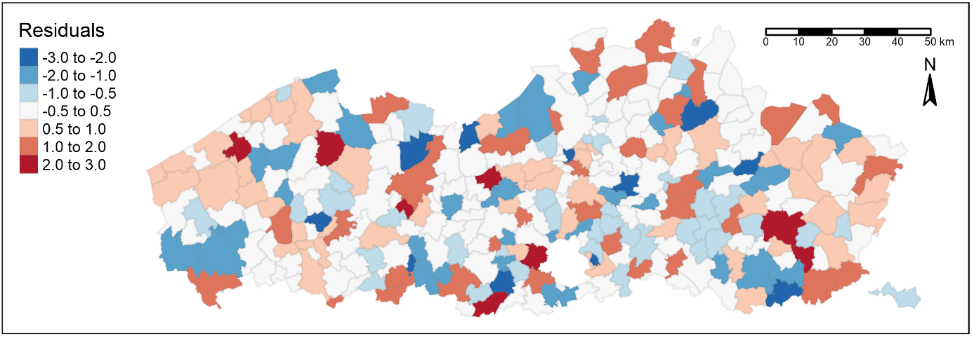
Results: spatial dependence modeling
While the Moran I is non-significant, and spatial dependance therefore does not seem apparent, plotting the spatial spread of residuals of the Standard OLS regression according to their standard deviations from the mean, does indicate some visual clustering on regions
Notes:
Following Tobler’s First Law of Geography that “everything is related to everything else, but near things are more related than distant things” (1970), the most common approaches are either using contiguity rook or queen criteria, or calculating a distance-based neighbours-set.
However, in both these cases, an expected relationship is linked to physical ‘nearness’ In the geographical pattern of Flanders however, municipalities are often somewhat less directly influenced by their neighbours, but depend more on the proximity to functional ‘centre cities’ (i.e., a central place configuration). This can be observed in the 2017 version of the Resident Survey, where respondents who indicated that they occasionally participated in shopping, cultural events or sports in other municipalities, were explicitly asked to name this town/city. As a result, spatial reliance between Flemish municipalities for certain activities is known. Considering that there should not be much difference between the 2017 and the 2020 situation – in terms of regional dependence – the spatial relations of 2017 were used as a basis for the modelling of an alternative spatial weight matrix that is not necessarily defined by shared boundaries

Slide 7
Conclusion
Since available statistical data are often bound by administrative borders, residential satisfaction and city love are often uniquely linked to facilities within the municipality/city
Particularly in cases such as Flanders, with relatively small distances between administrative units and good transport connections, residents often depend on neighbouring regions for particular activities (e.g. working, shopping, recreation)
Satisfaction with the own living environment can then be partly influenced by the level of connectivitiy between the own municipality and resource-rich neighbours (particularly urban areas)

Slide 8
Thanks for your attention! Questions?

