Slide 1
Multi-Criteria Decision Aiding to support the uptaking of Smart Sustainable Districts
Alessandro Luè
alessandro.lue@polimi.it
Smart and Resilient Urban Development - Facing the Challenges
XXVIII International Scientific Conference
Regional development and demographic flows of southeastern European countries
University of Niš | Faculty of economics
Niš, 23 June 2023

Slide 2
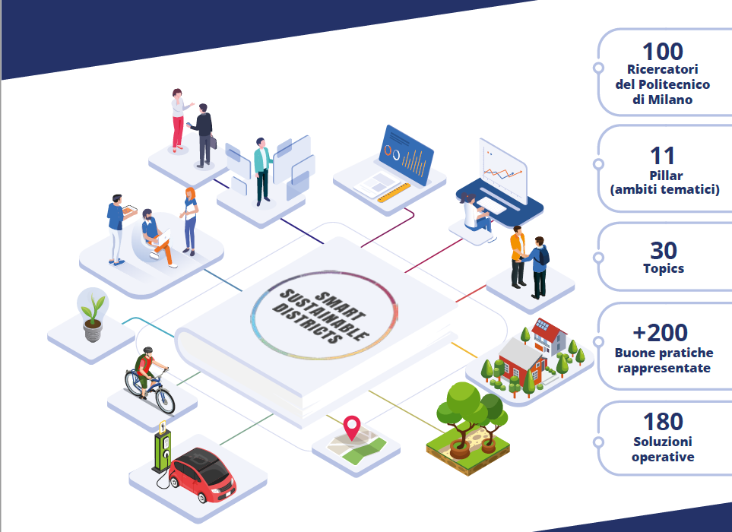
Smart Sustainable Districts
The Smart Sustainable Districts (SSD) project focuses on urban transformation through the lens of the urban districts
Promoted by Politecnico di Milano and coordinated by Consorzio Poliedra, the project started in 2021 and involved more than 100 researchers from all Departments and Consortia of Politecnico Proposes actions for the sustainable development, the ecological transition and the enhancement of resilience of places and communities at a local scale
Speak to local authorities and to the stakeholder that are active in urban and districts regeneration
credits: pensagrafica.it
www.poliedra.polimi.it/en/ssd-smart-sustainable-districts

Slide 3
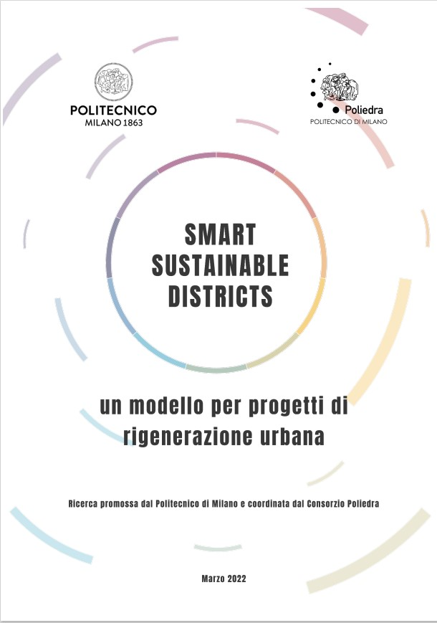
The SSD guidelines
Main output is a white paper, that aims to draft some practical guidelines to deal with planning and management of urban transformations at the district scale

Slide 4
The thematic areas (pillars)
Main output is a white paper, that aims to draft some practical guidelines to deal with planning and management of urban transformations at the district scale
The white paper is divided into 11 thematic areas (pillars) to represent urban districts from a smart and sustainable point of view and to define the possible lines of action

Slide 5
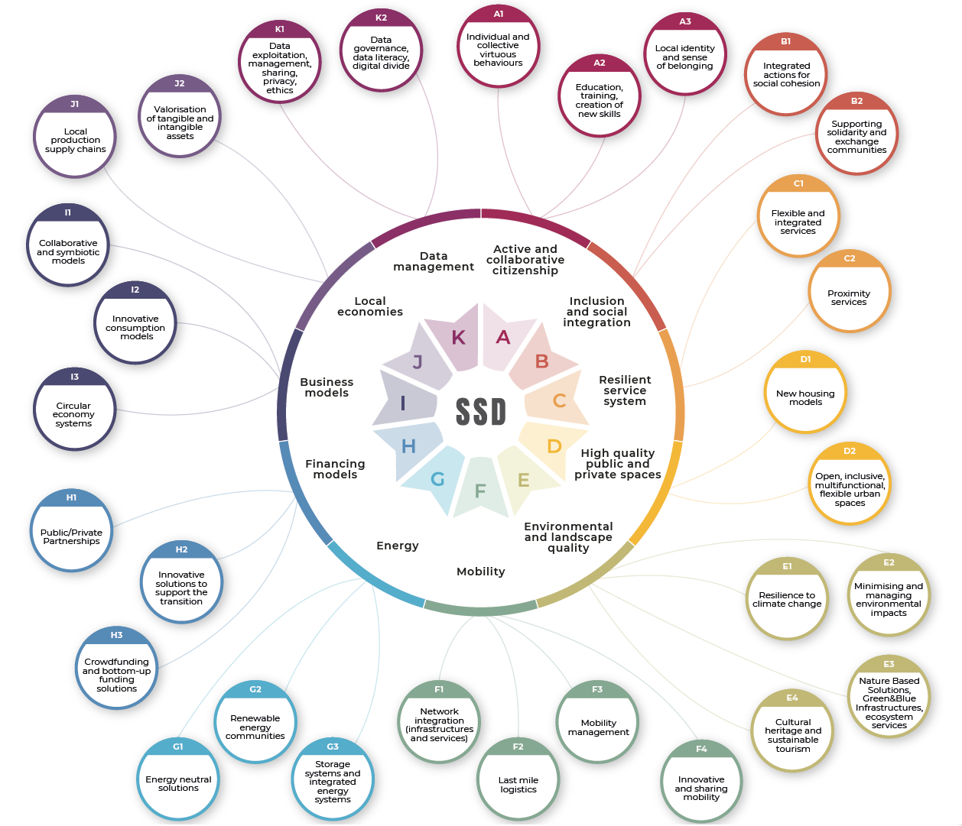
Topics and pillars
Main output is a white paper, that aims to draft some practical guidelines to deal with planning and management of urban transformations at the district scale
The white paper is divided into 11 thematic areas (pillars) to represent urban districts from a smart and sustainable point of view and to define the possible lines of action
For each pillar, some sub-areas have been identified (topics), to detail the possible actions and good practices

Slide 6
Topics and pillars
Main output is a white paper, that aims to draft some practical guidelines to deal with planning and management of urban transformations at the district scale
The white paper is divided into 11 thematic areas (pillars) to represent urban districts from a smart and sustainable point of view and to define the possible lines of action
For each pillar, some sub-areas have been identified (topics), to detail the possible actions and good practices

Slide 7
Topics and pillars
Main output is a white paper, that aims to draft some practical guidelines to deal with planning and management of urban transformations at the district scale
The white paper is divided into 11 thematic areas (pillars) to represent urban districts from a smart and sustainable point of view and to define the possible lines of action
For each pillar, some sub-areas have been identified (topics), to detail the possible actions and good practices

Slide 8
Topics and pillars
Main output is a white paper, that aims to draft some practical guidelines to deal with planning and management of urban transformations at the district scale
The white paper is divided into 11 thematic areas (pillars) to represent urban districts from a smart and sustainable point of view and to define the possible lines of action
For each pillar, some sub-areas have been identified (topics), to detail the possible actions and good practices

Slide 9
Mobility in Smart Sustainable Districts
F – Mobility
F1 – Network integration (infrastructure and services) P. Coppola, con P. Beria, L. Studer Intermodality Integration of mobility services Encouraging active mobility in accessing modal interchanges
F2 – Last mile logistics A. Tumino e A. Seghezzi, con F. Braghin, F. Cheli, R. Mangiaracina, V. Paruscio, C. Siragusa, D. Tarsitano, P. Tresca Optimising the delivery of small parcels and ultra-rapid delivery requests Micro-warehousing Small and electric vehicles (i.e. cargo bike) Drones and Robotics delivery
F3 – Mobility management L. Studer, con M. Brambilla, E. Perotto Define actions on working hours to reduce peak phenomena on collective transport Create facilities and infrastructures that facilitate the use of sustainable means of transport such as electric recharging stations, bicycle facilities (bicycle racks, bicycle repair spaces, showers) F4 – Innovative systems and sharing mobility M. Tanelli, con F. Bordignon, F. Braghin, F. Capella, F. Cheli, P. Coppola, S. Franzò, A. Lué, A. Nasca, V. Paruscio, L. Studer, E. Verga
Department of Design
Department of Mechanical Engineering
Department of Management, Economics and Industrial Engineering
Department of Electronics, Information and Bioengineering
Poliedra
Cefriel
MIP

Slide 10
Multi-Criteria Decision Aiding (MCDA)
MCDA
a formalized (not necessarily mathematical) method to reach synthesis conclusions regarding the choice among alternatives, considering conflicting criteria measured in different units
Different MCDA methods have been proposed and used, each one has advantages and weaknesses, but all MCDA methods follow
three main steps
Identification
Estimation of the (quantitative/qualitative) impacts of the alternatives
and the preferences associated to the impacts
Comparison of the alternatives
(methods to synthetize the information coming from the previous steps)
Scenarios
Stakeholders
Alternatives
Objectives & Criteria

Slide 11
Stakeholder engagement: a key element
MCDA can be used to enhance stakeholder engagement and support the decision making process
making decisions transparent and repeatable
establishing the conditions for a proactive participation of the stakeholders
helping to identify and manage conflict by facilitating discussion about criteria and priorities
⬇
improve the decision process and increase acceptance of the final outcome

Slide 12
Alessandro Luè
alessandro.lue@polimi.it
www.poliedra.polimi.it
Follow us!
linkedin.com/company/consorzio-poliedra
facebook.com/consorziopoliedra
twitter.com/CPoliedra
https://www.technologyreview.com/2020/03/17/905264/coronavirus-pandemic-social-distancing-18-months/
we won't return to normality because normality was the problem

