Slide 1
Unlocking Funding Opportunities:
Crafting Winning Project Proposals Workshop,
Niš, September 27-28, 2023
The structure of Horizon proposals: How to write Excellence, Impacts and Implementation?
UR-DATA
101059994 — UR-DATA — HORIZON-WIDERA-2021-ACCESS-02
Jelena J. Stanković, Faculty of Economics, University of Niš, Srbia

Slide 2
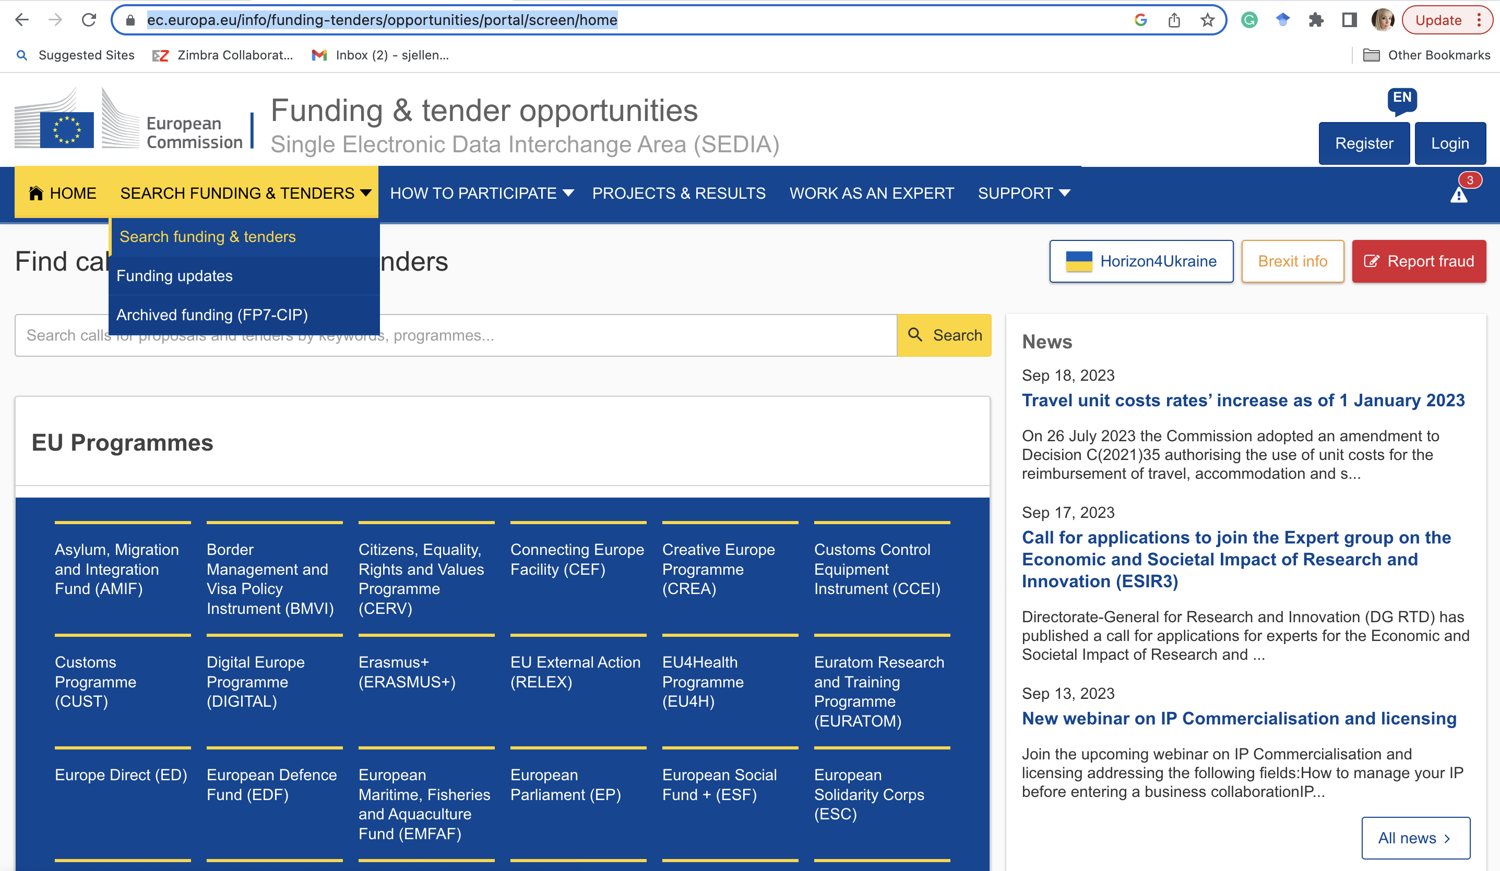
Funding and tender portal
https://ec.europa.eu/info/funding-tenders/opportunities/portal/screen/home

Slide 3
The structure of Horizon template
Excellence (threshold 3/5)
Impacts (threshold 3/5)
Implementation (threshold 3/5)
Total 15 (threshold 10/15)

Slide 4
Excellence

Slide 5
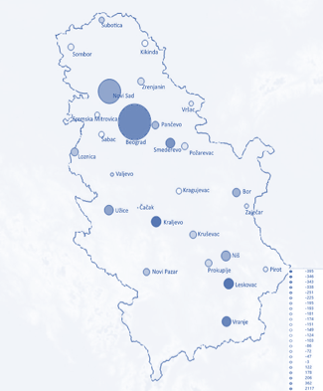
Motivation and vision
Urban growth is closely linked to the problem of uneven economic development, migration and demographic change, which often have adverse implications for human capital and the social and economic sustainability of urban areas even in the most developed countries.
Our world is becoming more computational. Following, urban areas are increasingly becoming data-rich environments. Herein, sustainability and resilience have grown into core analytical and normative concepts in the scientific arena.
Urban settlements in Serbia are facing depopulation and demographic aging, regional disparities, climate change and environmental problems. Twenty-two out of twenty-eight cities in Serbia are faced with a negative migration balance, while only Belgrade and Novi Sad have a significant influx of population

Slide 6
Project partners
Faculty of Economics, University of Niš (FEUN), Serbia
Poliedra - Polytechnic University of Milan (POLIEDRA), Italy
Oslo Metropolitan University (OSLOMET), Norway
Members of the UR-DATA Scientific Advisory Board (SAB)
No. | SAB Member | Affiliation
1 | Alexis Tsoukias | PSL University, Université Paris Dauphine, Paris, France, scientific field Operational Research
2 | Jason Papathanasiou | University of Macedonia, Thessaloniki, Greece, scientific field Decision Support Systems
3 | Pavle Petrović | Serbian Academy of Science and Arts member and the president of Fiscal Council of Republic of Serbia, Belgrade, Serbia, scientific field Econometrics
4 | Peter Nijkamp | The Faculty of Management, Open University, Heerlen, Netherlands, one of the leading European economists in the field of Regional Economics and Economic Geography
5 | Carlo Sessa | Research Director of the institute ISINNOVA, Rome, Italy, main area of expertise Foresight, Quality of Life Indicators and Community Engagement

Slide 7
Objectives
Overall project objective is to enhance networking activities between the FEUN and POLIEDRA and OSLOMET in order to increase the scientific recognition and impact of the FEUN in the field of smart and resilient urban and regional development using state-of-the-art data analytics and optimization tools in data-rich environment
Objective 1 | To enhance the scientific capacity of the FEUN through twinning
Objective 2 | To raise the research profile of FEUN and its staff
Objective 3 | To define sustaining long-term scientific strategy of FEUN for stepping up and stimulating scientific excellence
Objective 4 | To enhance career prospects for early stage researchers
Objective 5 | To strengthen administrative and project management skills of staff at FEUN

Slide 8
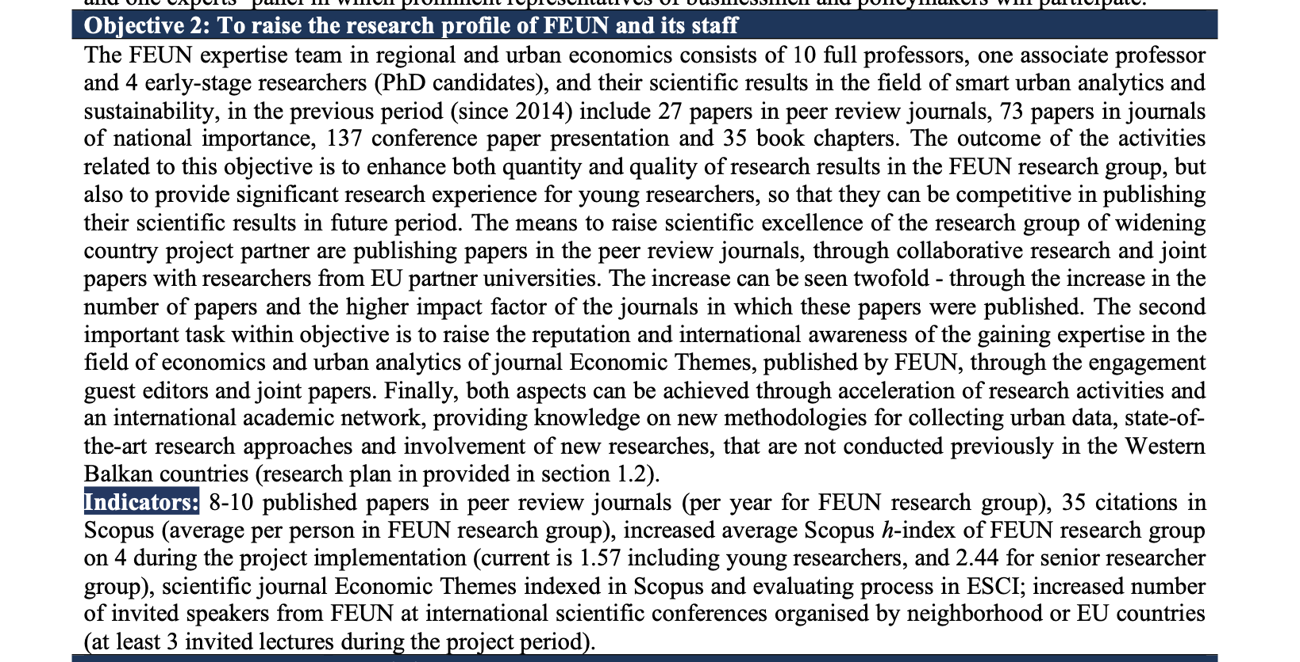

Slide 9
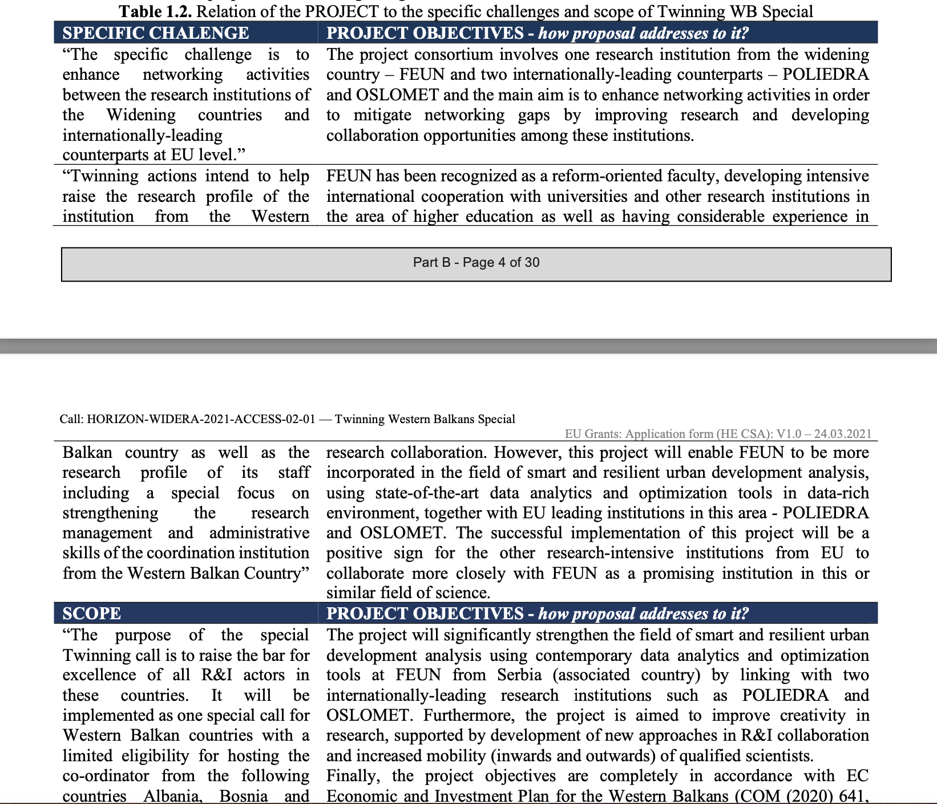

Slide 10
Five pillars of scientific excellence at FEUN

Slide 11
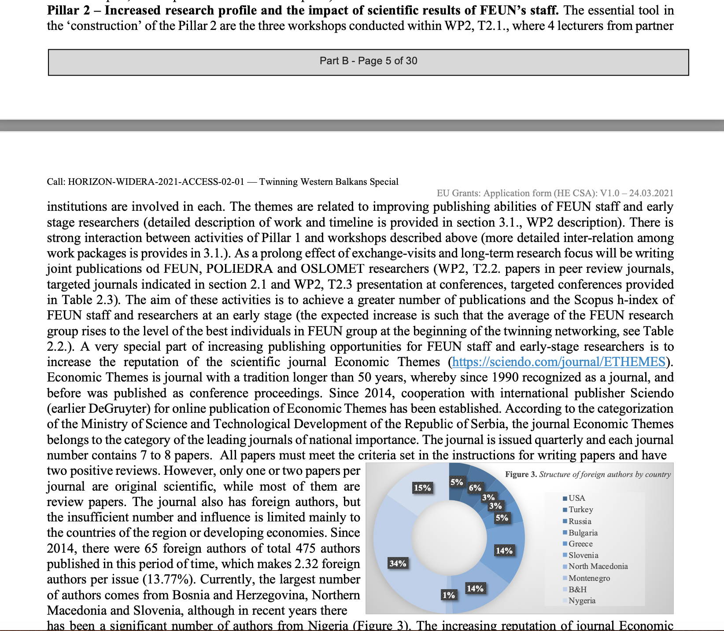

Slide 12
Impacts

Slide 13
Expected Results
Laboratory for Land Economics and Urban Analytics (LEUA) established at FEUN;
PM unit established at FEUN;
5 new projects (national and internationally funded) at FEUN;
10 new international cooperation contracts;
increased position at Academic Ranking of World Universities (Shanghai Ranking);
Open source database of analysis of performances of the cities in Serbia
8-10 published papers per year in peer review journals, increased average Scopus h-index (for FEUN research group);
increased number of foreign authors at the conference “Regional Development and Demographic Flows of South-Eastern Europe Countries”
increased number of foreign students at FEUN;
Scientific journal Economic Themes is indexed in Scopus and in evaluating process in ESCI;
increased number of invited speakers from FEUN at international scientific conferences organised by neighbouring or EU countries;
2 conference proceedings published by international publisher (Springer);
improved prospects for early-stage researchers at FEUN;
2 PhD doctoral dissertation in the field of project.

Slide 14
Expected Results
Laboratory for Land Economics and Urban Analytics (LEUA) established at FEUN;
PM unit established at FEUN;
5 new projects (national and internationally funded) at FEUN;
10 new international cooperation contracts;
increased position at Academic Ranking of World Universities (Shanghai Ranking);
Open source database of analysis of performances of the cities in Serbia
8-10 published papers per year in peer review journals, increased average Scopus h-index (for FEUN research group);
increased number of foreign authors at the conference “Regional Development and Demographic Flows of South-Eastern Europe Countries”
increased number of foreign students at FEUN;
Scientific journal Economic Themes is indexed in Scopus and in evaluating process in ESCI;
increased number of invited speakers from FEUN at international scientific conferences organised by neighbouring or EU countries;
2 conference proceedings published by international publisher (Springer);
improved prospects for early-stage researchers at FEUN;
2 PhD doctoral dissertation in the field of project.

Slide 15
Target Groups
Scientific community:
All teachers and associates employed at FEUN besides UR-DATA team members;
Early-stage researcher and PhD students at FEUN;
Science and Technology Park Niš;
Scientific community in the country, in the surrounding countries (project is supported by Center for Support of Smart and Sustainable Cities of the University of Rijeka, Croatia), but also in the international scientific community, through the publication of papers and presentations at eminent scientific conferences;
Policy makers:
Through the evaluation of urban development policies, UR-DATA targets policy makers at the local and national level, as potential users of research results (project is supported by the Ministry of Public Administration and Local Self-governments of Republic of Serbia; Ministry of Environmental Protection of Republic of Serbia; City of Niš, Office for Local Economic Development and Projects; and Commercial and Economic Council of the City of Niš);
Business representatives :
UR-DATA also explores issues of the smart economy and its impact on urban development, ecology and urban demography, and thus includes the business community in its target group, interested in the results of the project. UR-DATA was recognized as a useful result-oriented project by the Serbian Chamber of Commerce and Industry and Club of Businessmen of the City of Niš, which announced its participation in the round table and interest in the results of the research.

Slide 16
Impacts
Scientific:
Significantly increased scientific recognition of FEUN and increased research excellence of the coordinating institution;
Improved capability of FEUN to compete successfully for national, EU and internationally competitive research funding and accelerated project activities in the field of smart urban development;
Filling the gap in the availability of urban data will bring Republic of Serbia closer to the EU Urban Agenda;
Determined patterns in urban mobility and urban dynamics (no previous research in this field in Serbia);
Economic:
Strengthened ability of FEUN to expand cooperation with industry and policy makers and increased impact of FEUN on wider community – business and industry, policy makers and social actors.
Societal:
Raising awareness of citizens in Serbia on problems of urbanization;
Providing assessment of urban policies;
Providing risk assessment of floods in urban area, as one of the great problems of urban living.

Slide 17
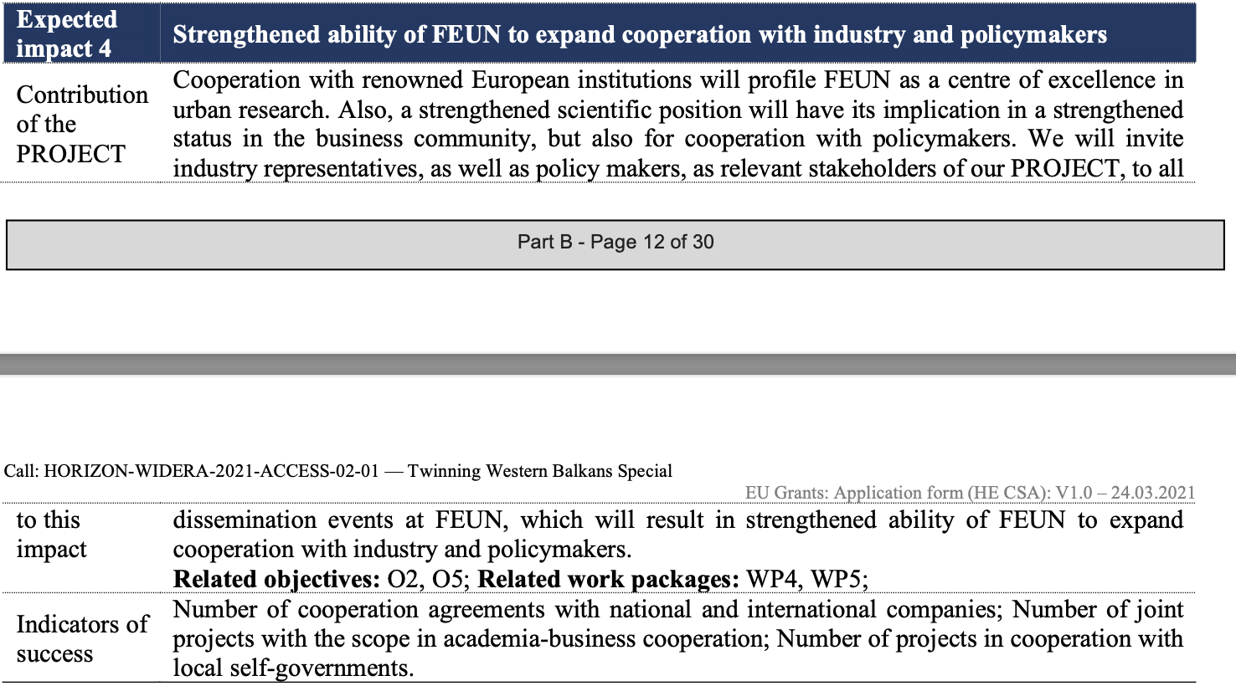
Expected Impact 4: Strengthened ability of FEUN to expand cooperation with industry and policymakers

Slide 18
Expected Impact 4: Indicators of success

Slide 19
Impacts

Slide 20
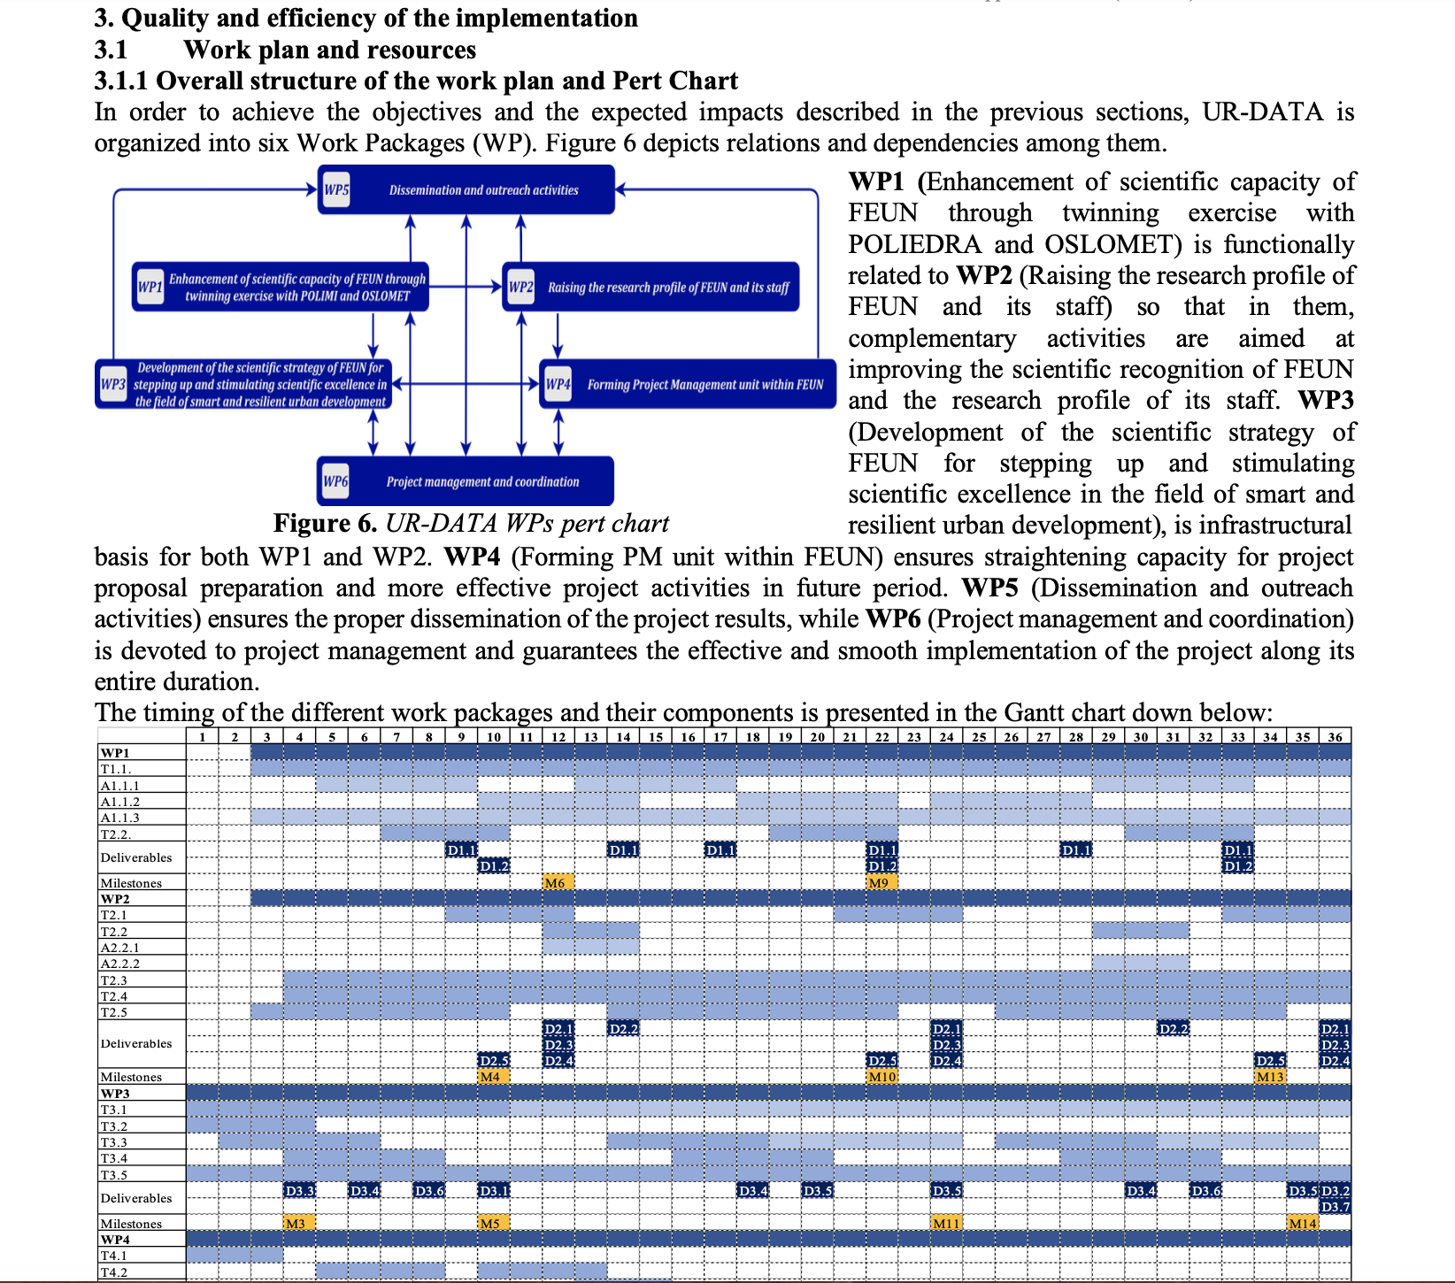

Slide 21
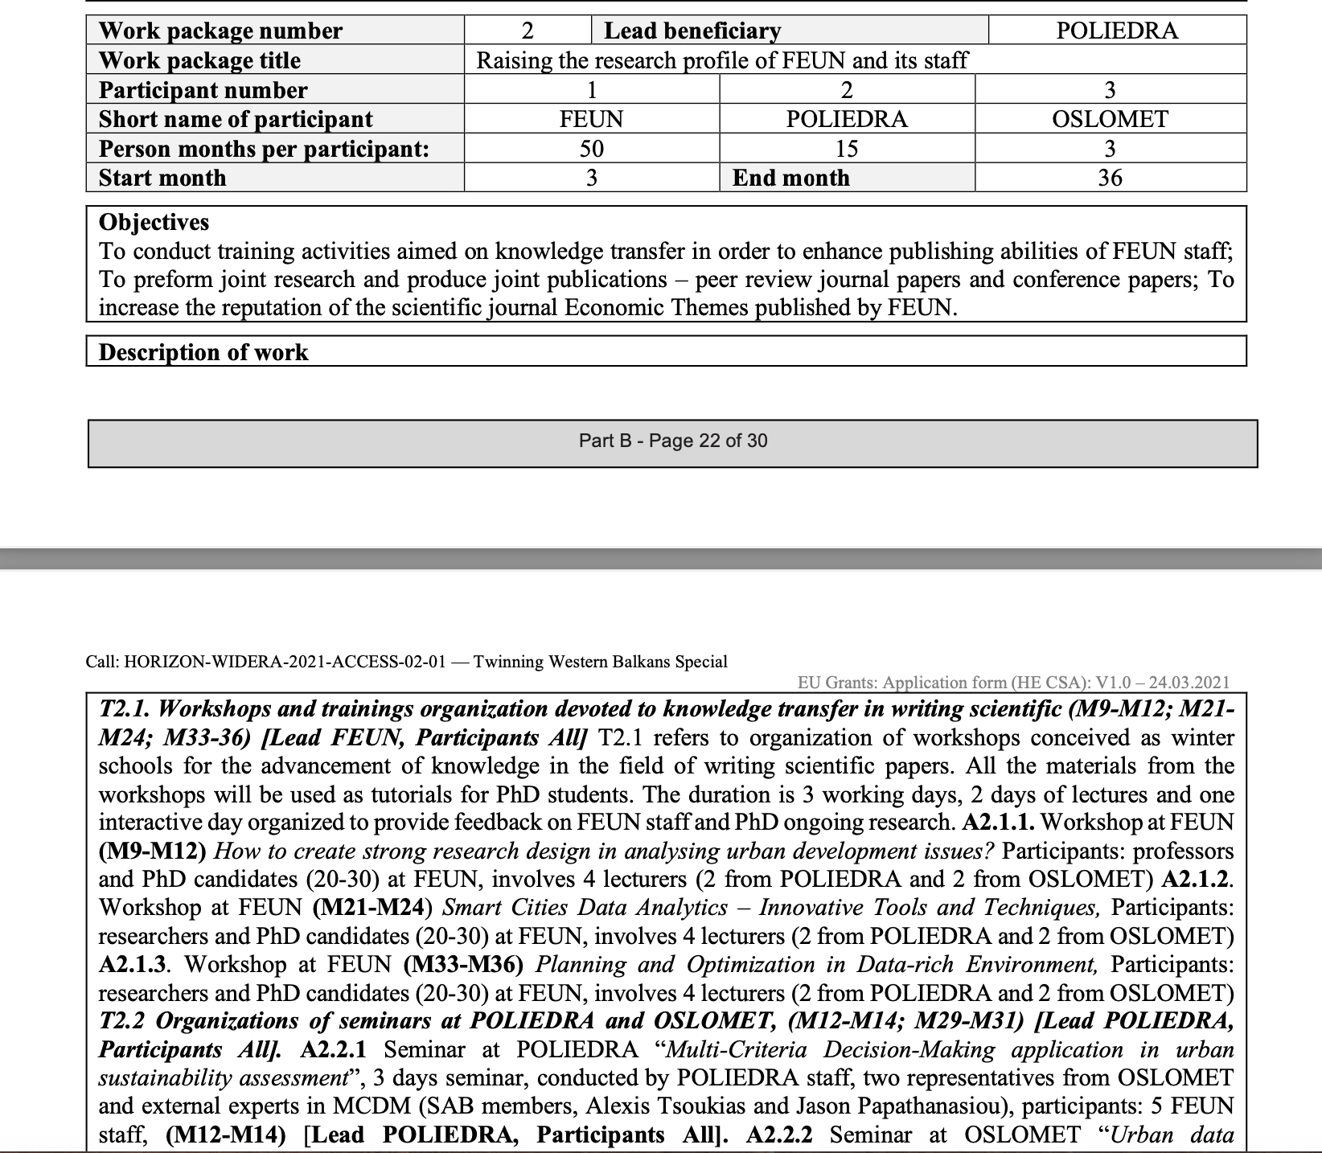

Slide 22
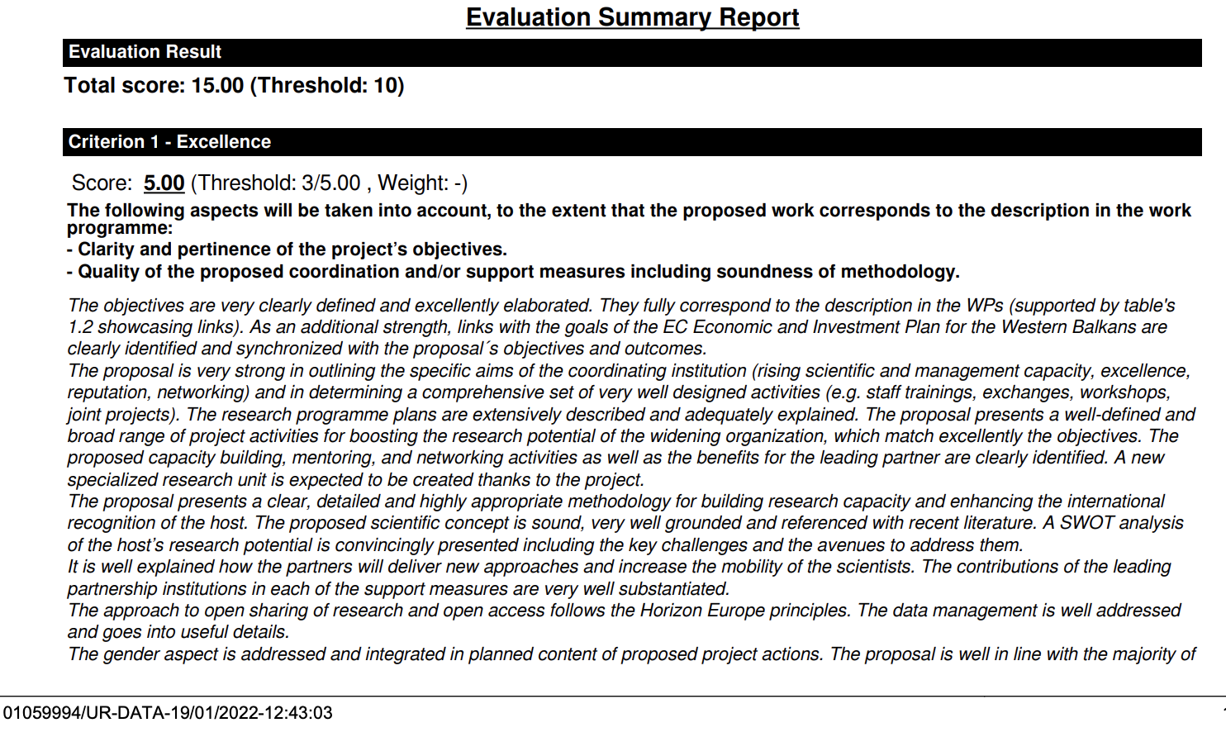
Rezultati evaluacije

Slide 23
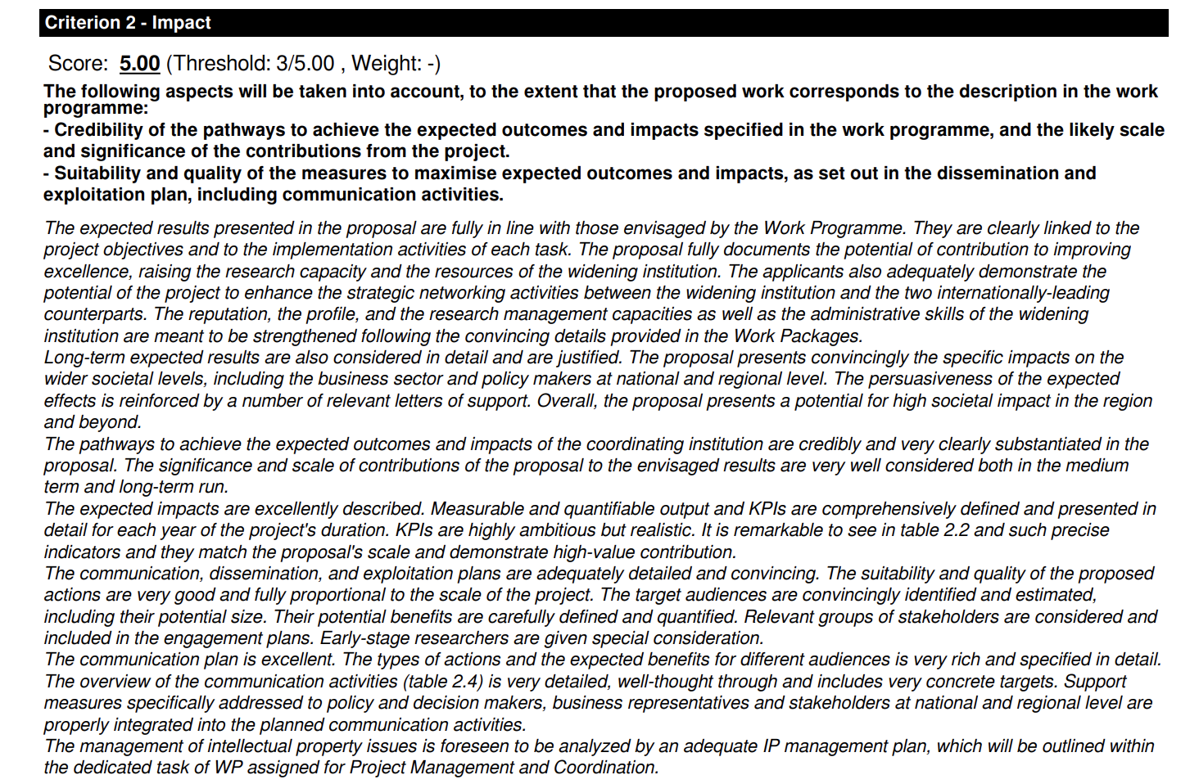
Rezultati evaluacije

Slide 24
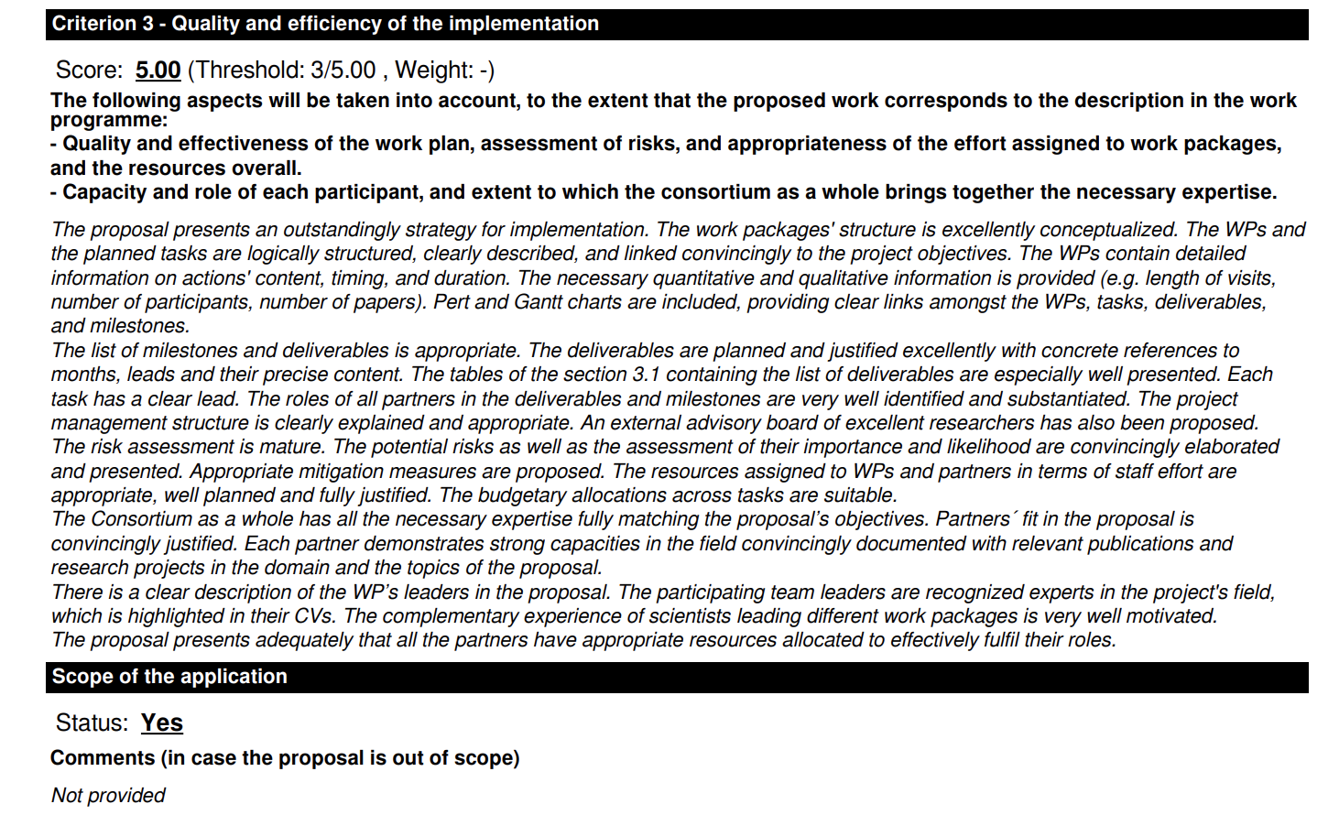
Rezultati evaluacije

