Slide 1
Too much to do and too little time: How reviewers get their job done and what it means for project proposal writing
UR-Data writing workshop
Claudia van der Laag | Oslo Metropolitan University
Niš, 27.09.2023

Slide 2
Important to keep in mind about the review process for research project applications
The research grant application review is an additional task to the aleady full calendar of reviewers
The reviewer is most likely a full professor or senior researcher with long-standing experience in academia (outside the EC organisation)
Motivation of a reviewer: Provide a service to the academic community, to learn about competition – landscape of the research market, and the honorarium
It is prestigious to be a EC reviewer and adds to their CV

Slide 3
Important to keep in mind about the review process for research project applications
Even reveiwers give their best to be objective, true objectivity is hard to achieve – to conduct a review takes a lot of effort and discipline from the reviewer
Do not think the reviewer does not recognize if the text is a bit vague or tries to sweep something under the carpet
Reviewer`s submit independet reviews and have to find consensus with other reviewers.
Weakness of proposals are always immediately identified by all reviewers.

Slide 4
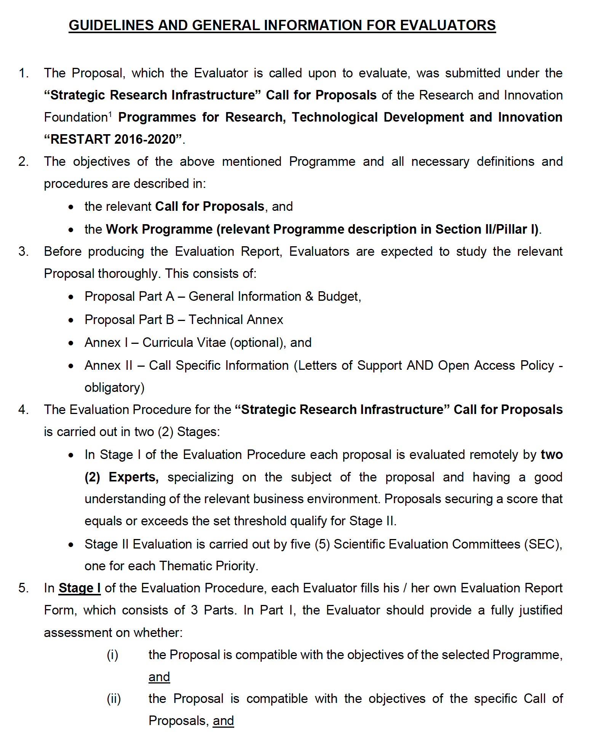
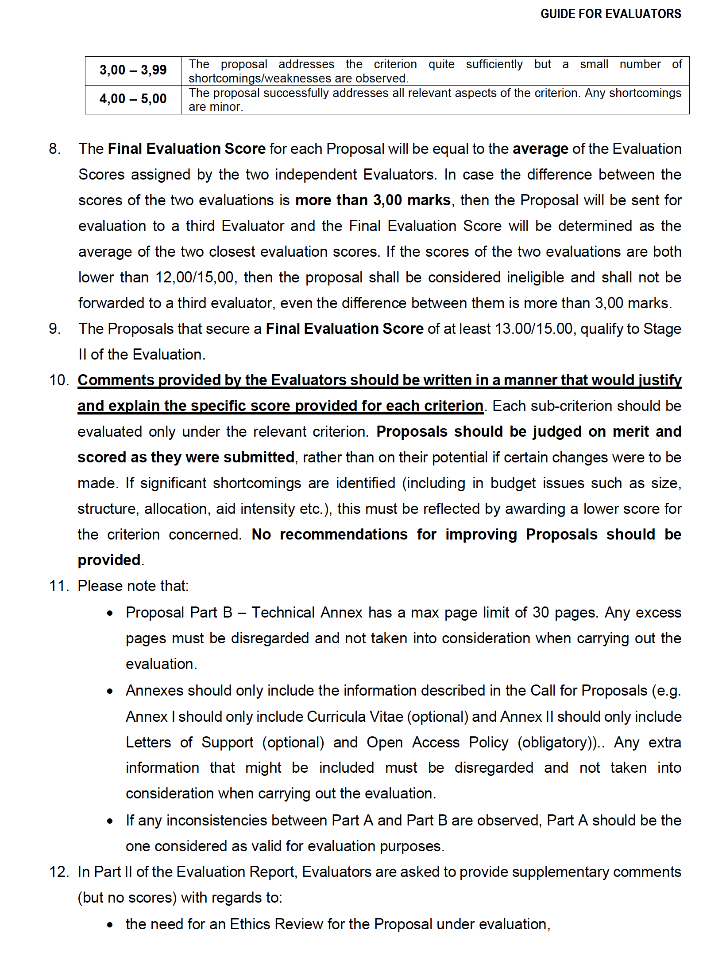
The reviewer`s guidelines (two-stage evaluation / European Union)

Slide 5
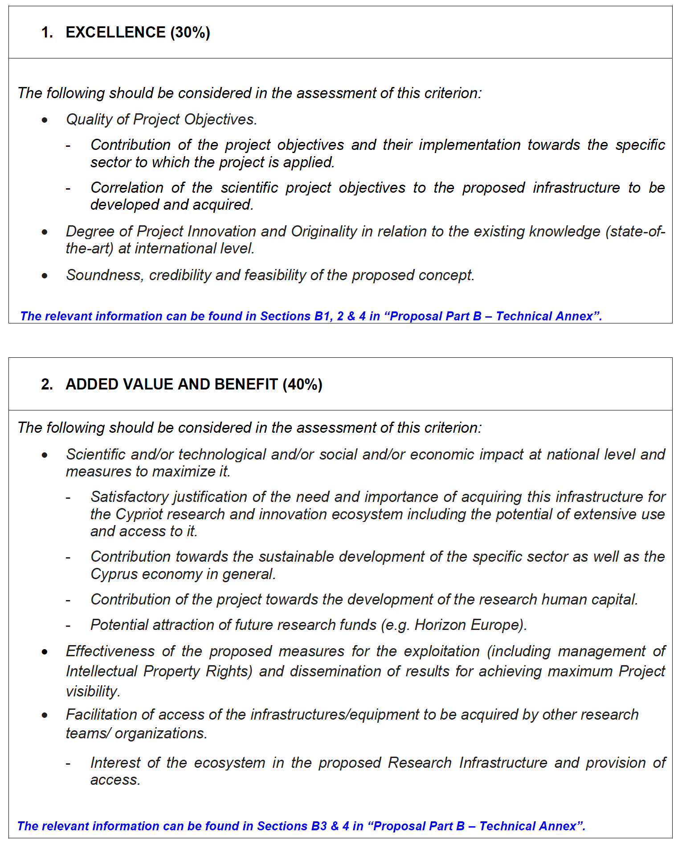
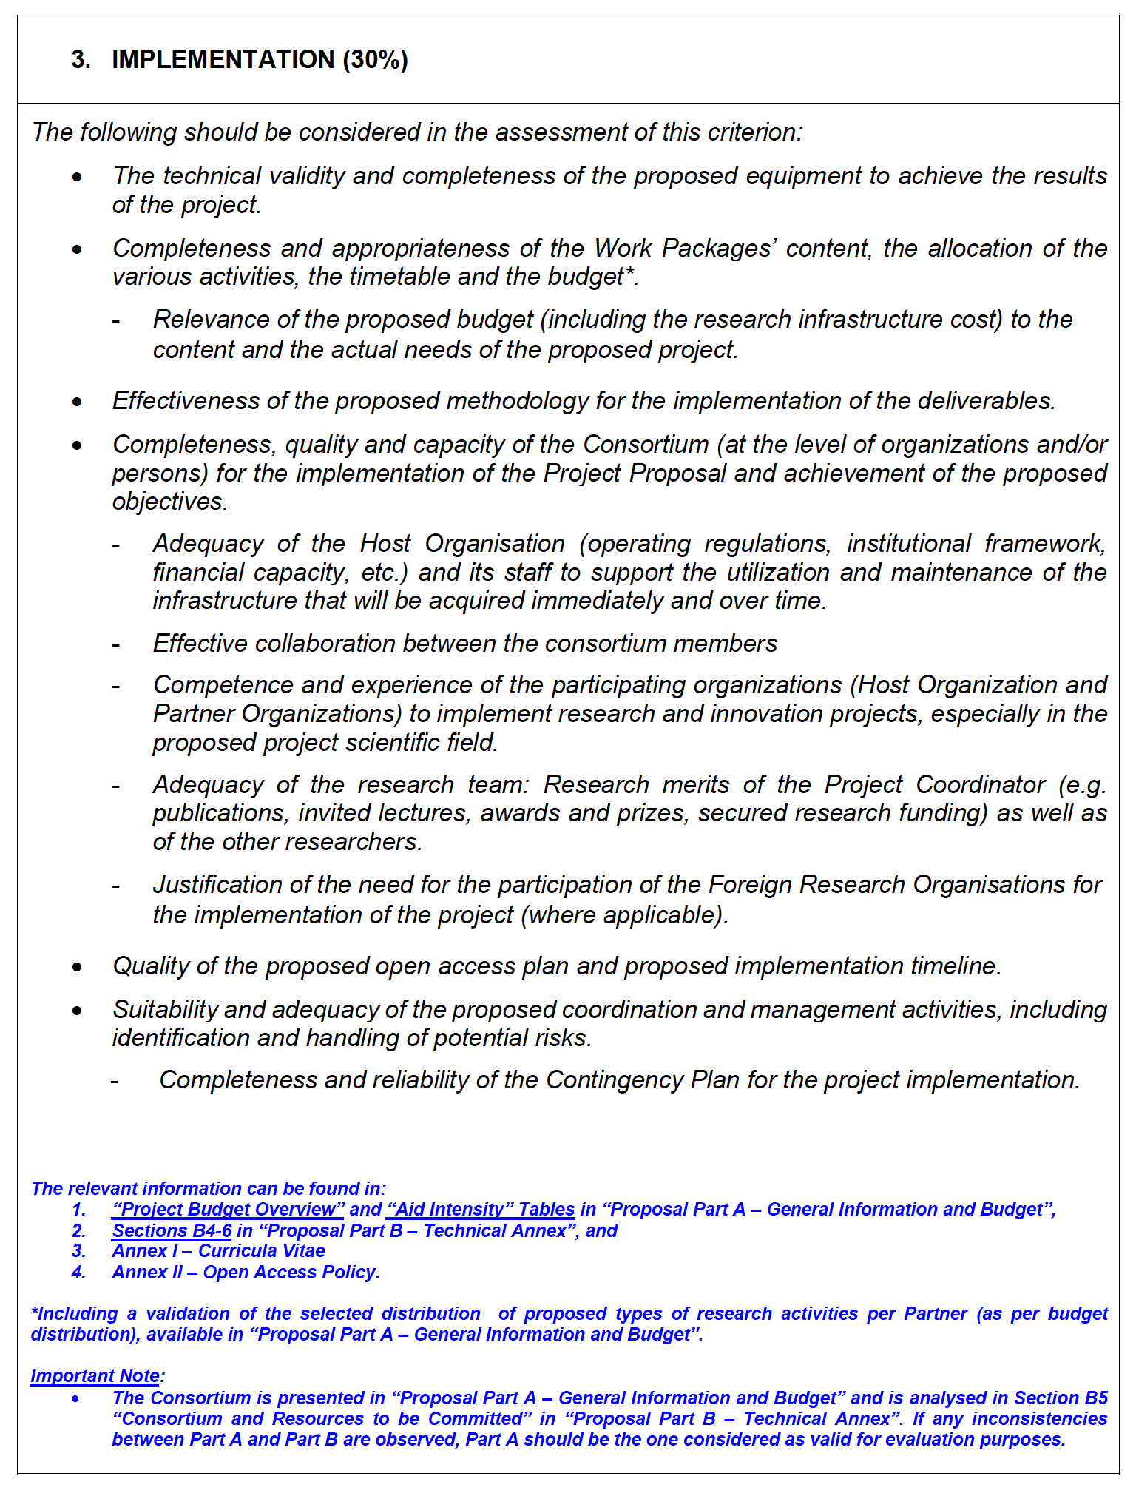
The reviewer`s guidelines (two-stage evaluation / European Union)

Slide 6
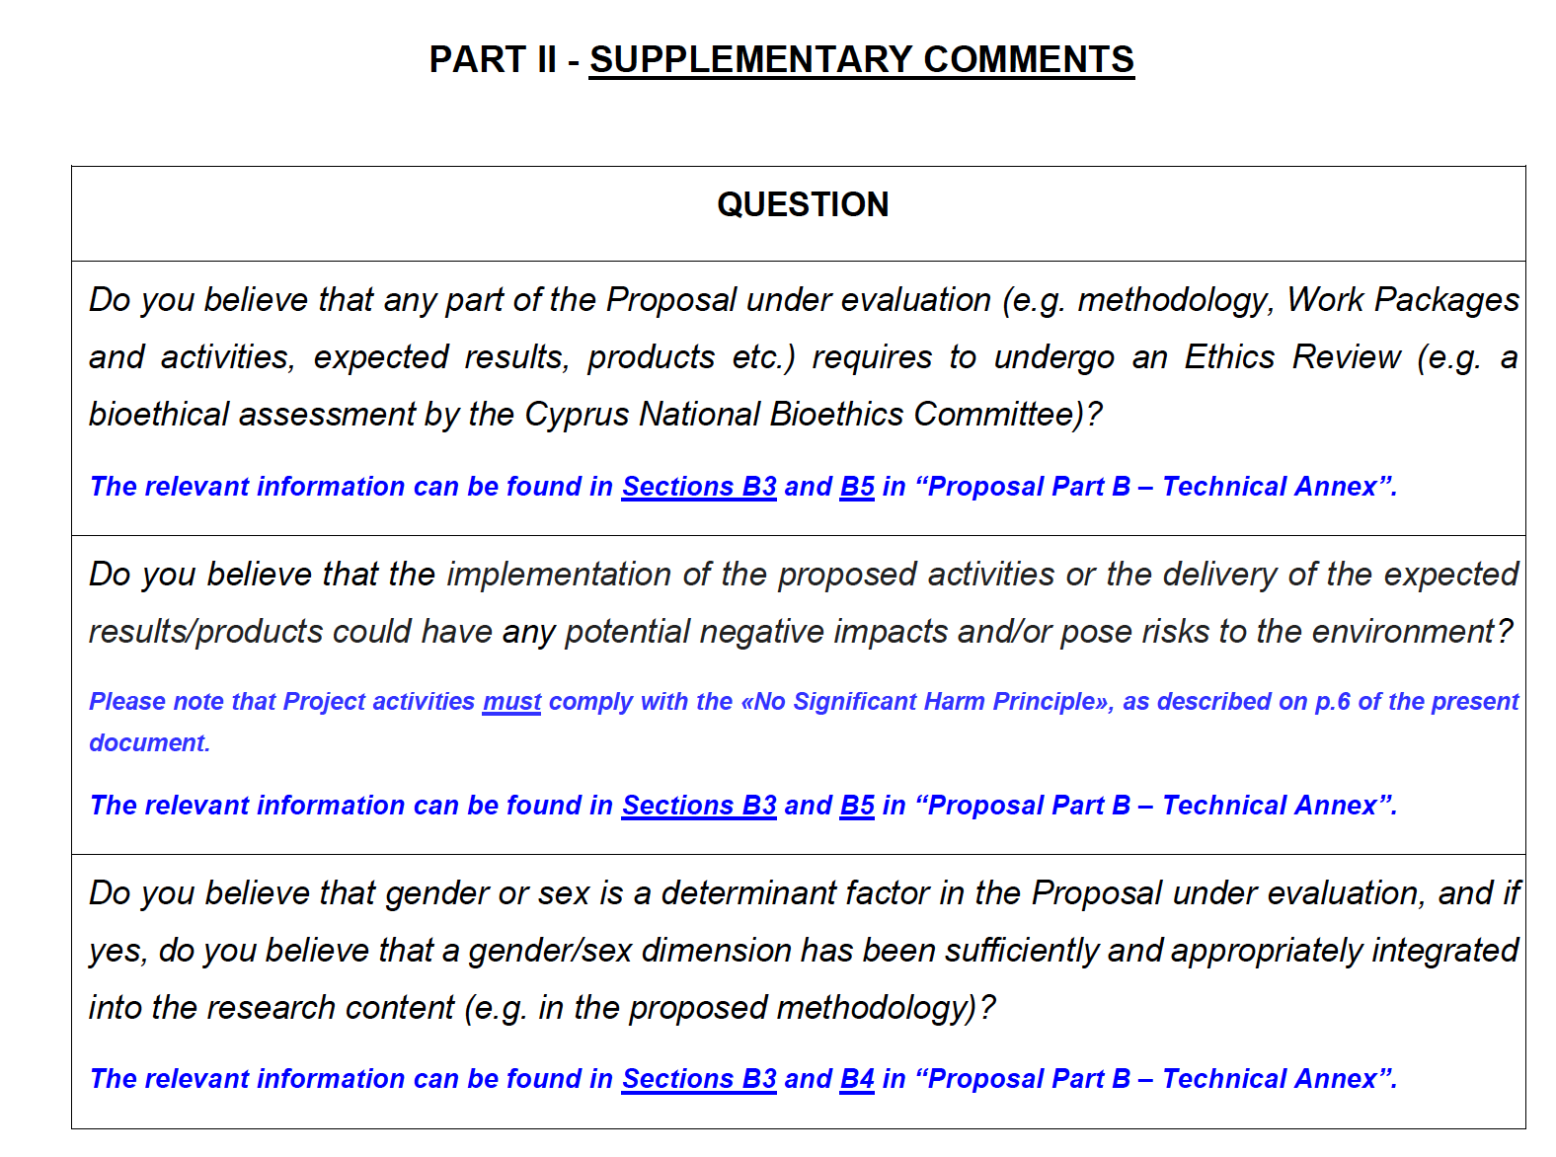
The reviewer`s guidelines (two-stage evaluation / European Union)
Ethics
No significant harm to the environment
Gender dimension

Slide 7
How to write a good research proposal from a reviewer`s perspective
Write in a simple, direct, for everyone understandable language
Do not overcomplicated matters: “Simplification is the mastership”
Have a stringend narrative that allows the reviewer to connect the different themes and work packages
Do not be vague! It indicates you have not fully developed your ideas
Support the reviewer. Write in such a way that the reviewer can easily connect your text to the standard evaluation format and finds quickly in the different paragraphs the needed text/phrases and argumentations for his review.
Gender dimension and ethics are very important! This can decide on swimming or sinking of your proposal.
Do not put the management work package to the forefront of your proposal. It is often the last work package.
Create a separate workpackage on the gender dimension.
Be aesthetic! A messy text layout does no good for you. Keep figures simple and clear.

Slide 8
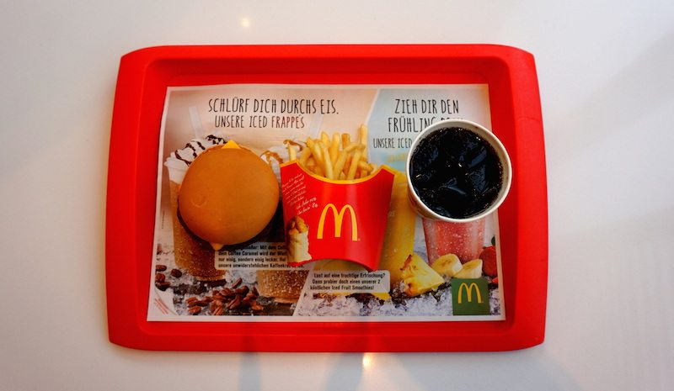
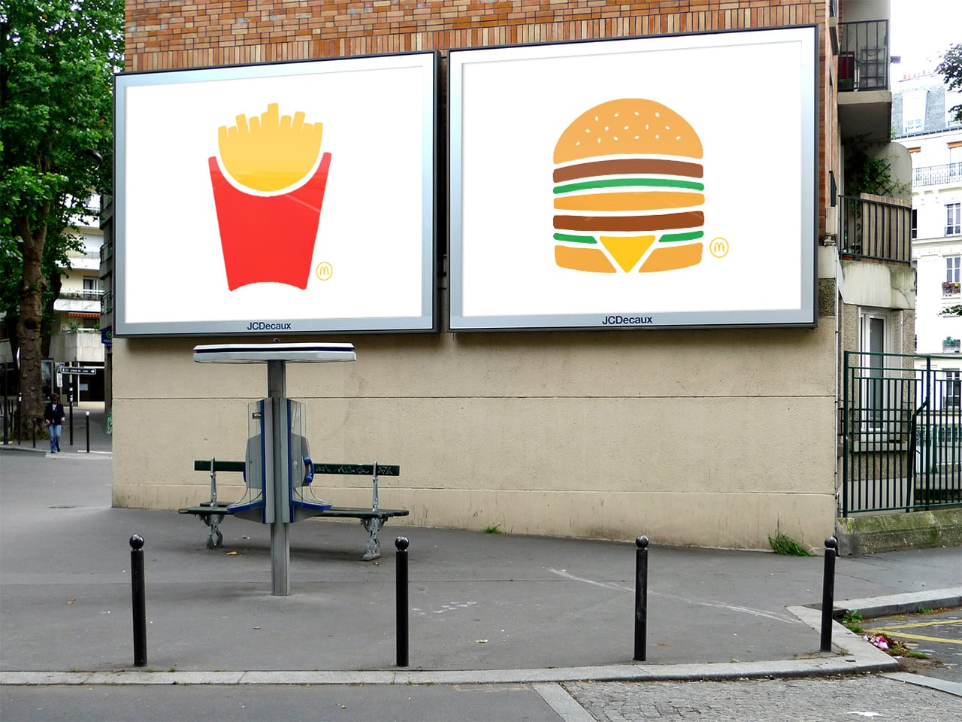
The memorizing effect

Slide 9
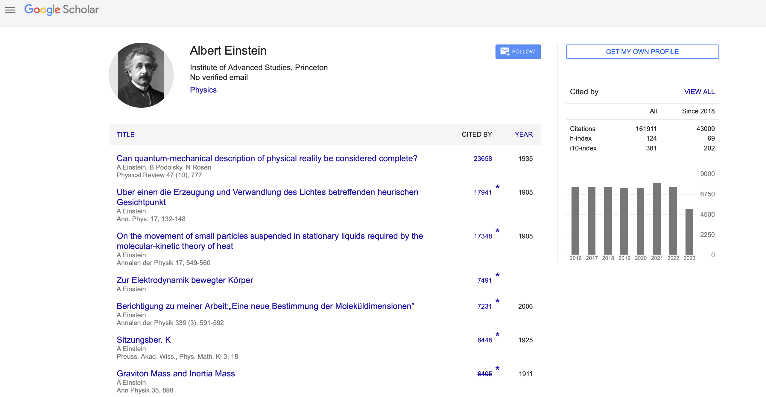
Google is a reviewer`s best friend

Slide 10
Best practices: Writing is an intense process
Time is not on your side, but the determinant:
Take your time to write a proposal; logistics and organisation with different partners are a time-consuming process
Know your partners!
5 steps to consider
Study well the writing criteria of the respective programme and ensure that you keep yourself updated with the latest i.e. EC templates.
Create a template of the document, where you will insert all the sections and the sub-sections required by the EC.
Study well the materials the partner(s) have shared to fully understand the a) concept; b) project objectives; and c) business model/plan.
Study successfully granted project applications and their reviews. Use them as inspiration
Calculate how much time you need to write your proposal (3-4 weeks is even for experienced writters to little; think more in months – also depending on the material you get from your partners)

Slide 11
Best practices: Writing is an intense process
Have a kick-off meeting and regular meetings for an efficient and effective writing process.
The team spirit is highly important. Take the lead in the writing process.
Share created template with your partners with indicating bullet points or questions where partners need to fill in their text. Ease their writing process. Be on top of the narrative and message you want to convey.
Keep in close communication with partners. Often a short phone call clarifies more than a long email exchange.

Slide 12
Best practices: Writing is an intense process
Create the Wow Effect
Insert a small text box (15-20 lines) in the first page after the list of participants and table of contents, introducting innovation and unique selling points against its market impact and sustaining management. (There is an ambivalence in projects that only cover financially the project duration, but cannot be sustained or grow in the long-term.
Manage the perception of the reviewer
Present main aspects of the proposal in the first couple of pages – similar to an executive summary: (a) current siutation of the market and challenges, (b) existing solutions and their limitations, (c) opportunity and how it is created through the advised project, (d) scope of the proposal and key novelties including a brief intriduction of the consortium and the role they play in the project.
S

Slide 13
Best practices: Writing is an intense process
Aesthetics are important
Have enough spacing between text lines to ease the reading flow
Keep the text neat
Do not use too many colours
Have simple and clear figures
Highlight what is important

Slide 14
Gender dimension
You might swim or sink with the gender dimension work package
Address the weaknesses in your field and how you close it.
Lean towards existing gender dimension/diversity protocols, reports, etc. – reference these

Slide 15
Examples: Review structures – ISRAEL
Originality & innovation
Project importance and contribution to scientific knowledge
Adequacy of methods
Suitability of investigators` scientific background to the project
Summary of strengths and weaknesses of the proposal

Slide 16
Examples: Review structures – CZECH REPUBLIC
Quality of the project proposal:
Originality, scientific importance, project prospects and expected benefits of the project research
Preparedness of the project proposal, methodology, concept, project aim and proposed deliveries
Co-applicant and other members of the research team
Qualification of the applicant
Overall commentary on the project proposal
Strengths of the project proposal
Weaknesses of the project proposal
General comments

Slide 17
Examples: Review structures – CYPRUS
Compatibility with the objectives of the programme and the call for proposals
Excellence
Added value and benefit
Implementation
Ethics
Potential risks to the environment
Gender balance

Slide 18
Take aways

Slide 19
Claudia van der Laag
claudiah@oslomet.no

