Slide 1
The Smart Sustainable Districts framework to improve mobility in cities: opportunities, tools and barriers
Alberto Colorni, Pierluigi Coppola, Alessandro Luè, Valerio Mazzeschi, Valerio Paruscio, Arianna Seghezzi, Jelena Stanković, Luca Studer, Mara Tanelli, Angela Tumino
alessandro.lue@polimi.it
51st European Transport Conference 6-8 September 2023 | Politecnico di Milano | Italy

Slide 2
SSD and UR-data: a cross-fertilization
Twinning for Excellence in Smart and Resilient Urban Development: Advanced Data Analytics Approach
Transfer of knowledge, experience and best practices at the University of Niš, Poliedra, and Oslo Metropolitan University, to increase the research excellence in the analysis of smart and sustainable performance of cities
The Smart Sustainable Districts (SSD) project focuses on urban transformation at district level
Promoted by Politecnico di Milano and coordinated by Poliedra
European Union’s HORIZON-WIDERA-2021-ACCESS-02-01: Twinning Western Balkans Special programme
https://www.poliedra.polimi.it/en/ssd-smart-sustainable-districts/
https://urdataproject.com/

Slide 3
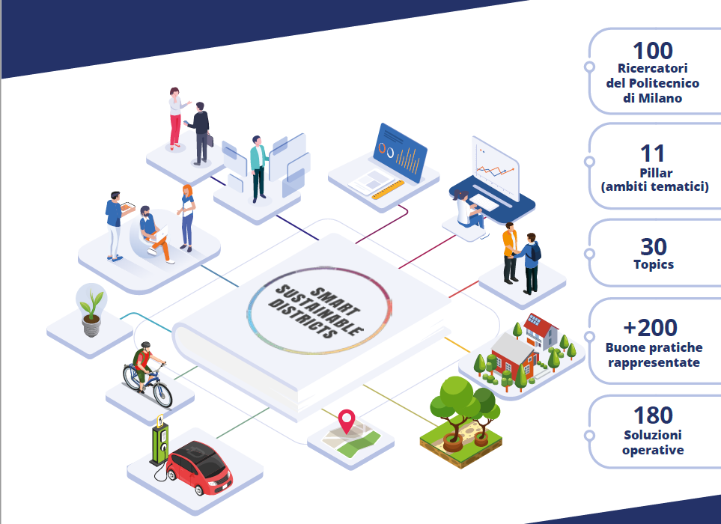
Smart Sustainable Districts
The SSD project focuses on urban transformation through the lens of the urban districts
The project started in 2021 and involved more than 100 researchers from all Departments and Consortia of Politecnico
Proposes actions for the sustainable development, the ecological transition and the enhancement of resilience of places and communities at a local scale
Speak to local authorities and to the stakeholder that are active in urban and districts regeneration
credits: pensagrafica.it
www.poliedra.polimi.it/en/ssd-smart-sustainable-districts

Slide 4
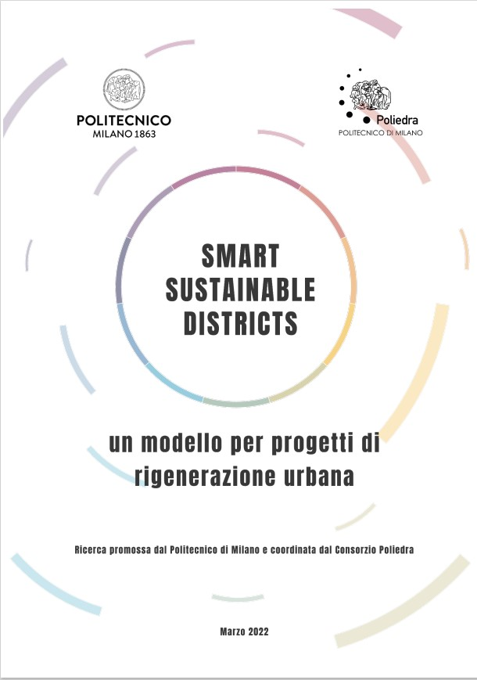
The SSD guidelines
Main output is a white paper, that aims to draft some practical guidelines to deal with planning and management of urban transformations at the district scale

Slide 5
The thematic areas (pillars)
Main output is a white paper, that aims to draft some practical guidelines to deal with planning and management of urban transformations at the district scale
The white paper is divided into 11 thematic areas (pillars) to represent urban districts from a smart and sustainable point of view and to define the possible lines of action

Slide 6
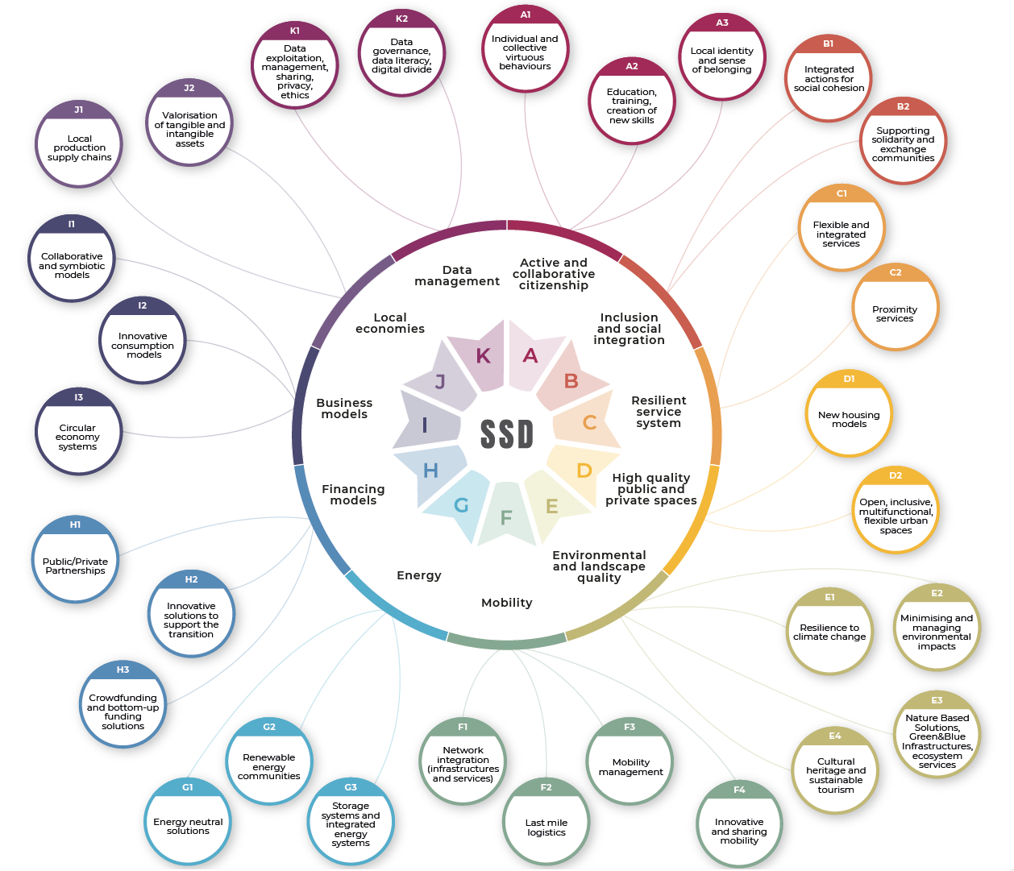
Topics and pillars
Main output is a white paper, that aims to draft some practical guidelines to deal with planning and management of urban transformations at the district scale
The white paper is divided into 11 thematic areas (pillars) to represent urban districts from a smart and sustainable point of view and to define the possible lines of action
For each pillar, some sub-areas have been identified (topics), to detail the possible actions and good practices

Slide 7
Mobility in Smart Sustainable Districts
Network integration (infrastructure and services) P. Coppola, with P. Beria, L. Studer Intermodality Integration of mobility services Encouraging active mobility in accessing modal interchanges
Last mile logistics A. Tumino e A. Seghezzi, with F. Braghin, F. Cheli, R. Mangiaracina, V. Paruscio, C. Siragusa, D. Tarsitano, P. Tresca Optimising the delivery of small parcels and ultra-rapid delivery requests Micro-warehousing Small and electric vehicles (i.e. cargo bike) Drones and Robotics delivery
Mobility management L. Studer, with M. Brambilla, E. Perotto Define actions on working hours to reduce peak phenomena on collective transport Create facilities and infrastructures that facilitate the use of sustainable means of transport such as electric recharging stations, bicycle facilities (bicycle racks, bicycle repair spaces, showers)
Innovative systems and sharing mobility M. Tanelli, with F. Bordignon, F. Braghin, F. Capella, F. Cheli, P. Coppola, S. Franzò, A. Lué, A. Nasca, V. Paruscio, L. Studer, E. Verga Providing alternative and integrated mobility services to the private car Developing MaaS (Mobility as a Service) systems
Department of Design
Department of Mechanical Engineering
Department of Management, Economics and Industrial Engineering
Department of Electronics, Information and Bioengineering
Poliedra
Cefriel
MIP

Slide 8
Integration between networks (infrastructure and services)
Strategies and policies
Intermodality: connecting modes of transport for travel
Solutions (some)
Dedicated spaces for shared modes of transport (cars, bicycles, mopeds, ...)
Best Practices (some)
Major Station Project (Italian Railway Network)
EX-TRA-Experimenting with city streets to TRAnsform urban mobility (Politecnico di Milano)
Bay Area Rapid Transit (City of San Francisco)
Integration of mobility services: integrating services for mobility within the SSD through integrated tariffs
Encouraging active mobility in accessing modal interchanges
Modal diversion towards public transport: through the development of local public transport stations
Integrated design of interchange nodes, minimising walking distances
Charging stations for electric vehicles
Cycle lanes and parking facilities for (private) bicycles
Pedestrian areas and protected pedestrian paths for access/egress.
Spaces adapted to flows, free of architectural barriers

Slide 9
Last mile logistics
Strategies and policies
Solutions (some)
Best Practices (some)
Micro-warehousing
Small vehicles
Electric Vehicles
Drones and Robotics delivery
Electric vehicles
Autonomous vehicles
Parcel Locker
Drones
Micro-hubs
Cargo Bike
…
Autonomous vehicle deliver during COVID-19 pandemic (EIT Urban Mobility)
Amazon Parcel Locker (Amazon)
Zero emission urban goods transportation (Municipality of Milan)

Slide 10
Mobility Management Actions
Strategies and policies
Solutions (some)
Best Practices (some)
Reduce the use of polluting vehicles
Improve the quality of systematic travel
Define actions on working hours to reduce peak phenomena on collective transport
Create facilities and infrastructures that facilitate the use of sustainable means of transport such as electric
recharging stations, bicycle facilities (bicycle racks, bicycle repair spaces, showers).
Conventions with LPT, sharing companies
Promotion of car pooling
Organisation of collective shuttles
Discounts on the purchase of less polluting vehicles
Limitation of the number of available car spaces
Definition of bonus policies
Modulation of entry/exit times
Smart Working
Pedibus
Home-work travel plan (Politecnico di Milano)
Mobility4Mi (AMAT-Milan Municipality)
Merezzate+ project (Poliedra-Politecnico di Milano)

Slide 11
Innovative systems and sharing mobility
Strategies and policies
Solutions (some)
Best practices (some)
Providing alternative and integrated mobility services to the private car
Exploit the opportunities of new technologies to improve mobility services
Developing MaaS (Mobility as a Service) systems
Community car-sharing
Hub stations
Promotion of active mobility
Charging stations
MaaS policies and integrator systems
Community Car Sharing (Poliedra and Politecnico di Milano, EIT Climate KIC)
MAAS4ITALY in Milano
(Comune di Milano and AMAT)

Slide 12
Transferability process
The transferability process: practices will be selected and adapted depending on the target city characteristics.
Five core aspects identified:
city objectives,
legal framework,
political framework,
public acceptability, and
enforcement issues related to local self-government.

Slide 13
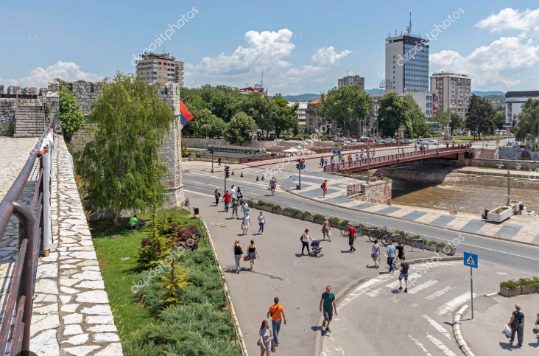
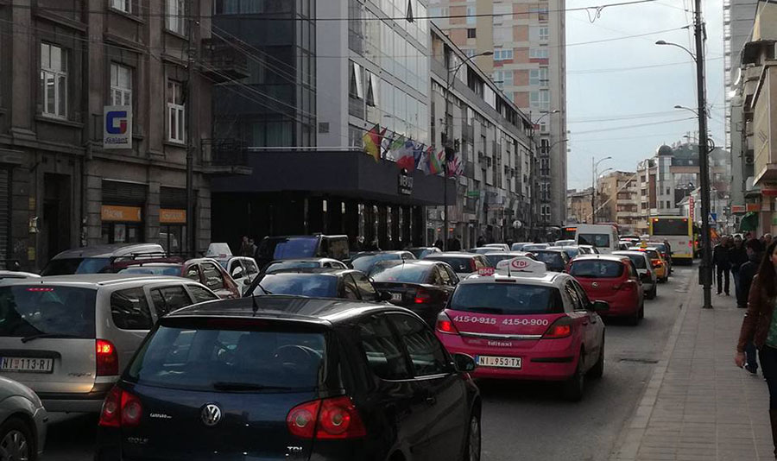
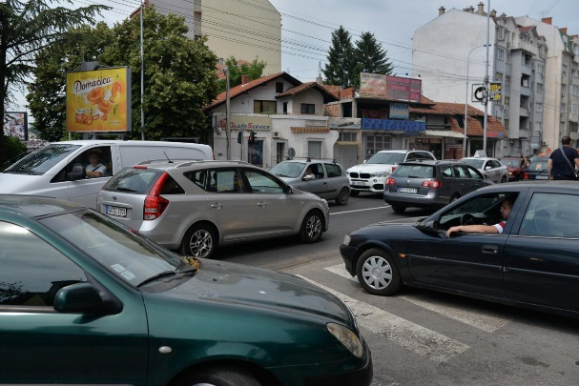
The city of Niš (Serbia)
Niš is one of the oldest cities in the Balkans, known as the "gateway" of East and West, due to its geographical position. The city is located at the crossroads of Western Europe with the Middle East and Greece. Niš is the third largest city in Serbia (population: 260,000)
Mobility
Mainly private mobility → significant congestion (also due to difficulties in parking)
Public transport system based on buses (lines departing from the center of the city)
Bicycle lanes (poorly marked and inaccessible) cover only 10 km
Car-centric urban and transport planning

Slide 14
Transferability process
Within UR-data, the following SSD solutions will be studied and eventually proposed for the city Niš, within the process of designing the Niš Sustainable Urban Mobility Plan (SUMP)

Slide 15
Potential solutions for Niš (1/2)
Re-design of public space to promote active transport and sharing mobility (including bike sharing stations and e-scooters), connect well to public transit, and discourage the use of cars. E.g., through the conversion of car parking places or street areas into public spaces, or the re-design of infrastructure around points of interest (e.g. shopping malls, schools, businesses, etc.)
Design and realization of bike lanes
Sharing mobility introduction (bike sharing, carpooling, etc.)
Bus stop allocation in accordance with citizens’ needs
Optimisation of public transport and integration of local and regional networks (at the moment, public transport in the City of Niš is organized with several different operators managing single routes)

Slide 16
Potential solutions for Niš (2/2)
Citizen mobility apps to provide real-time information about public transport in the single districts and shared mobility services, as well as personalized recommendations for their trip based on their needs and preferences. Other features could include a reward program to incentivize the modal shift to shared mobility and public transport, personal footprint, fitness goals, multimodal points/credits, and integration with other reward programs
Soft activities to raise awareness about sustainable mobility
Development of a comprehensive evaluation and monitoring system, e.g. effects of introducing bike sharing point in the city that does not have previous experience in sharing mobility services

Slide 17
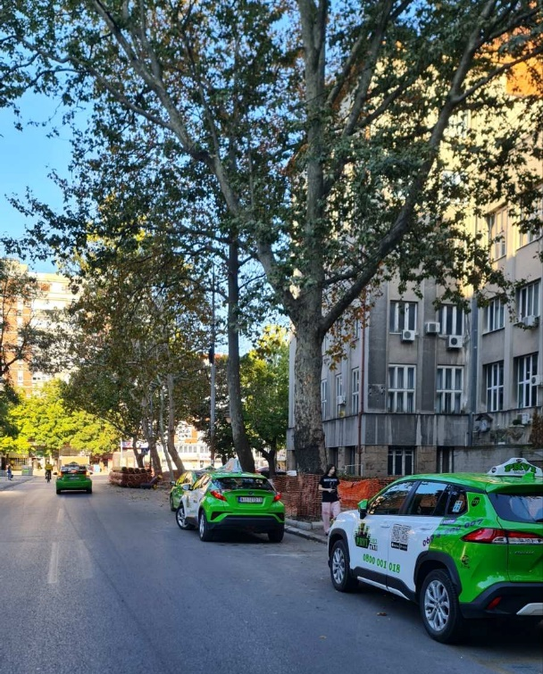
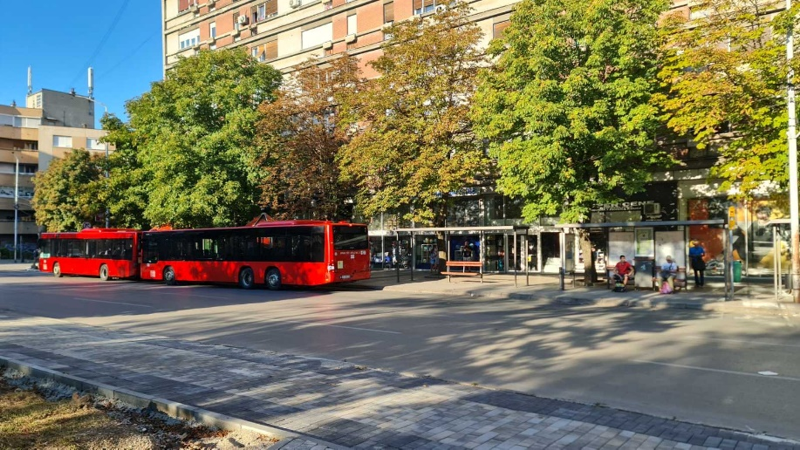
Avalaible data
Data that will be used in transferability process
GPS data on public transport (including traffic data and data on the number of passengers on individual routes)
Mobile phone data (provided by Telekom Serbia)
GPS data from taxi services
Data on traffic accidents and violations (Traffic Police of the Police Administration) and on parking violations (Municipal Police)
Data on public garages and parking in the city

Slide 18
Conclusions (1/2)
By integrating the principles and solutions from the SSD project with the UR-DATA project's objectives → a more comprehensive and sustainable urban transformation plan for the City of Niš
Improved Urban Planning | The SSD focus on sustainable district-level transformations can complement the UR-DATA project's focus on urban mobility planning: Niš can create a holistic approach that ensures public spaces, transportation networks, and community needs are all integrated effectively
Active Transport and Public Transit Enhancement | The SSD & UR-DATA integration can result in the creation of plans and projects for implementation of well-connected bike lanes, redesign of public spaces, optimized bus stop locations, and improved integration of local and regional transit networks
Technology Integration for Sustainable Mobility | Leveraging the insights from the SSD project, Niš can incorporate technology-driven solutions into the UR-DATA project. This includes the development of citizen mobility apps for real-time information, reward programs to incentivize sustainable modal shifts, and a comprehensive monitoring system to evaluate the impact of mobility services. These tech-driven initiatives can enhance the effectiveness of Niš' Sustainable Urban Mobility Plan (SUMP)

Slide 19
Conclusions (2/2)
SSD can represent a useful toolbox to holistically plan a new urban district or to regenerate an existing one
Most of the proposed SSD actions at the local scale. As regards mobility, integration of different territorial levels: Local ↔ City ↔ Regional/national
Transferability to Serbia (and in general, where sustainable mobility measures are not widespread)
Challenge | adapt the SSD mobility solutions to the Serbian context apply best practices and solutions that are already consolidated in many European countries
Opportunity | leapfrog towards sustainable mobility systems, skipping some of the inefficient stages of development experienced by industrialised countries

Slide 20
Thank you
Alberto Colorni, Pierluigi Coppola, Alessandro Luè, Valerio Mazzeschi, Valerio Paruscio, Arianna Seghezzi, Jelena Stanković, Luca Studer, Mara Tanelli, Angela Tumino
alessandro.lue@polimi.it
This project has received funding from the European Union’s HORIZON-WIDERA-2021-ACCESS-02-01: Twinning Western Balkans Special programme. Grant agreement No 101059994

