Slide 1
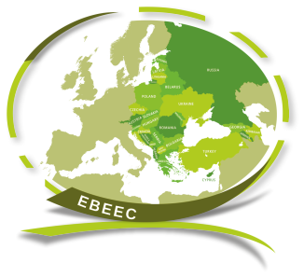
15th International Conference Economies of the Balkan and Eastern European Countries ΕΒΕΕC 2023
May 12-14, 2023
Chios, Greece
ADVANCING SUSTAINABLE DEVELOPMENT IN THE REPUBLIC OF SERBIA: CHALLENGES AND OPPORTUNITIES
Authors: Jelena J. Stanković, Ivana Marjanović, Sandra Milanović*, Milica Jovanović Vujatović, Marina Stanojević
Faculty of Economics, University of Niš, Trg kralja Aleksandra Ujedinitelja 11, 18000 Niš, Serbia
*sandra.milanovic@eknfak.ni.ac.rs

Slide 2
Presentation outline:
Introduction
The Concept of Sustainable Development in the European Union
Progress and Challenges Towards Achieving the Sustainable Development Goals in Serbia
Conclusion

Slide 3
Introduction
As the Republic of Serbia is in the process of negotiations in order to be admitted to the European Union (EU), it strives to the successful implementation of reforms together with the implementation of the concept of sustainable development (Jelisavac Trošić, 2018).
In 2008, Serbia has adopted strategy of sustainable development, while currently having mapped all SDGs through various documents.
All SDGs are incorporated in various Serbian strategies could be related to the negotiation’s chapters such as:
Negotiating chapter | SDGs
Fundamentals | 16
Internal market | 3
Competitiveness and inclusive growth | 1, 4, 5, 8, 9, 10
Green Deal and Sustainable Connectivity | 6, 7, 11, 12, 13, 15
Resources, agriculture and cohesion | 2
External relations | 17

Slide 4
The Concept of Sustainable Development in the European Union
As the EU works to strike a balance between economic growth, social advancement, and environmental protection, as the sustainable development is a key objective. The idea of sustainable development recognizes that social justice and environmental degradation cannot be sacrificed in the sake of economic growth.
Covered by numerous regulations such as:
European Green Deal - a new growth strategy to create inclusive and healthy society with a knowledge-driven, resource-efficient and competitive economy, without emissions of greenhouse gases in 2050 (the transition towards the goal of a climate-neutral economy by reducing carbon emissions by at least 50% by 2030 and achieving carbon neutrality by 2050);
Creating a legal framework making the EU climate neutral by 2050;
Gender Equality Strategy 2020-2025;
New Industrial Strategy for Europe;
A new Circular Economy Action Plan for a cleaner and more competitive Europe;
European Skills Agenda for sustainable competitiveness etc. (European Commission, 2023).

Slide 5
Progress and Challenges Towards Achieving the Sustainable Development Goals in Serbia
Comparison of coverage of SDGs by Serbian strategies 2017-2022
1. No poverty
2. Zero hunger
3. Good health
4. Quality education
5. Gender equality
6. Clean water and sanitation
7. Affordable and renewable energy
8. Decent work and economic growth
9. Industry, innovation and infrastructure
10. Reduced inequalities
11. Sustainable cities and communities
12. Responsible consumption and production
13. Climate action
14. Life below water
15. Life on land
16. Peace, justice and strong institutions
17. Partnership for the Goals
Source: GIZ (2017, 2022)

Slide 6
Progress and Challenges Towards Achieving the Sustainable Development Goals in Serbia
One analysis's findings revealed that there are only minor variations between the mapping of the SDG strategic framework during Serbia's EU joining membership process and the more comprehensive approach taken by Agenda 2030. In actuality, the SDGs related to fundamental and existential components received the highest ranking, followed by environmental and social values (Ristović, 2022).
The outcomes also demonstrated that adopting the new methodology, which involves combining the chapters into clusters and relocating the SDGs indicators as necessary, produced improved outcomes (Ristović, 2022).
Serbia has embarked on the road towards achieving 17 SDGs, and the progress in each SDG is primary analyzed in details based on the data of the Statistical Office of the Republic of Serbia (Available at: https://data.stat.gov.rs/?caller=SDGUN&languageCode=en-US)
Source: GIZ (2022)

Slide 7
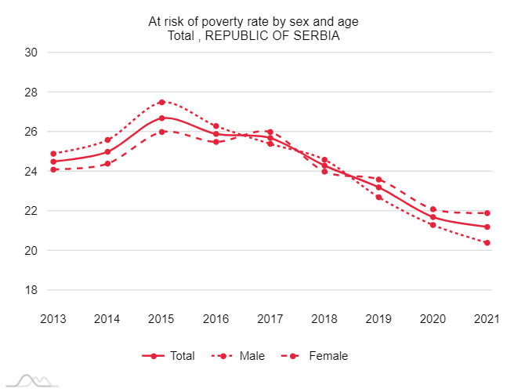
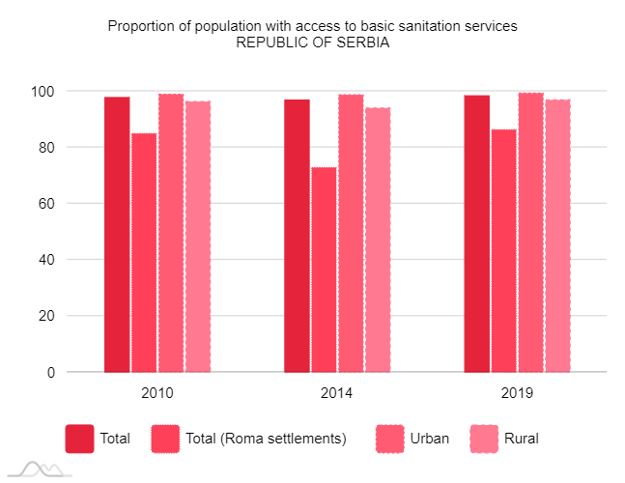
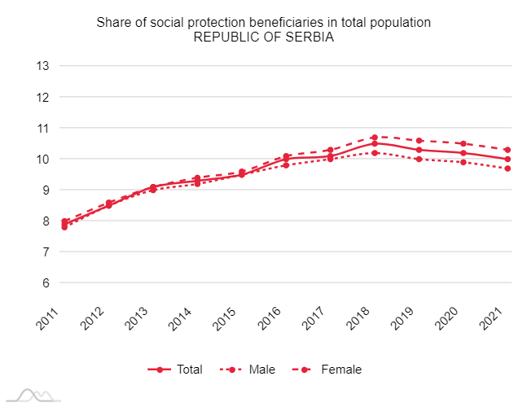
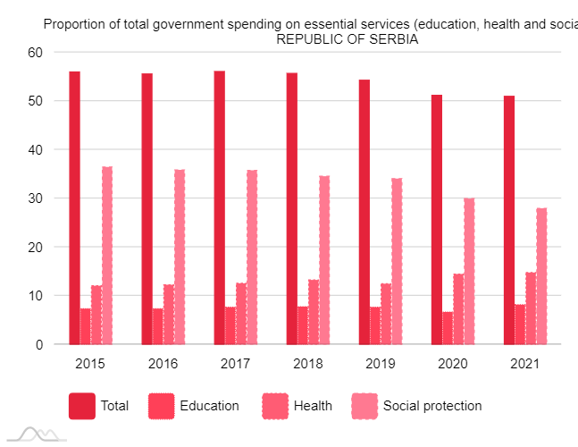
SDG 1. End poverty in all its forms everywhere:
*The proportion of population living below the national poverty line has declined over the years but is still among the highest in Europe.
* Average pension for march 2023 is 322e.

Slide 8
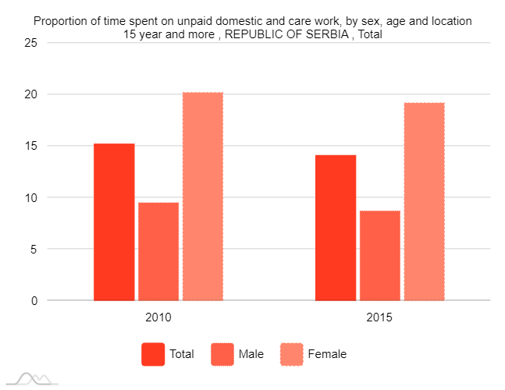
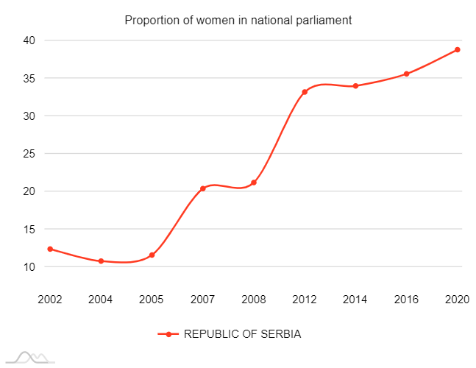
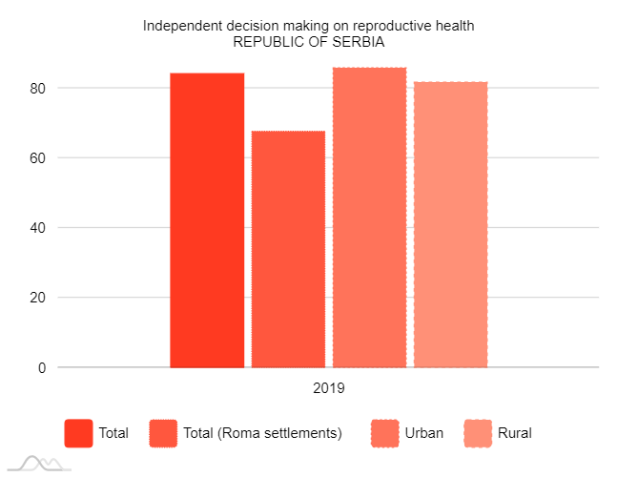
* It can be seen that the Republic of Serbia has made progress in promoting gender equality, particularly in the area of education.
* The country has achieved gender parity in primary and secondary education and has made progress in increasing the number of women in parliament.
* The Global Gender Gap Index for 2022 indicates that Serbia is 23rd place out of 146 ranked countries
SDG 5. Achieve gender equality and empower all women and girls:

Slide 9
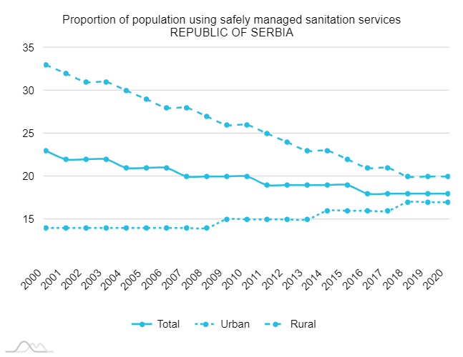
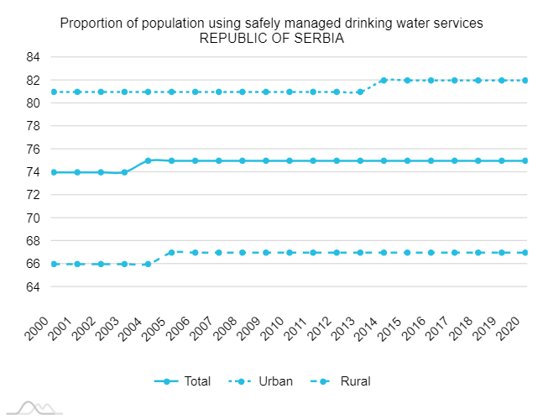
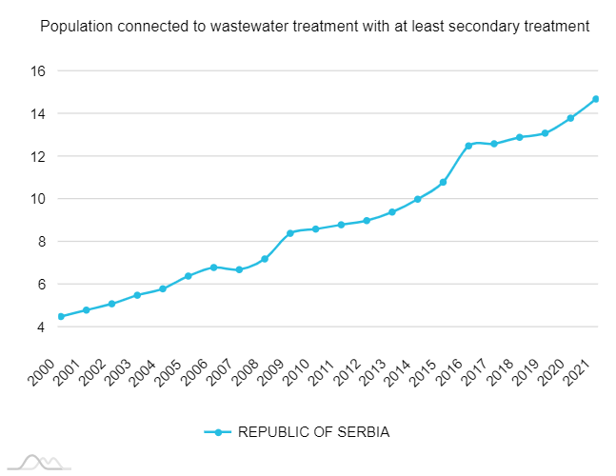
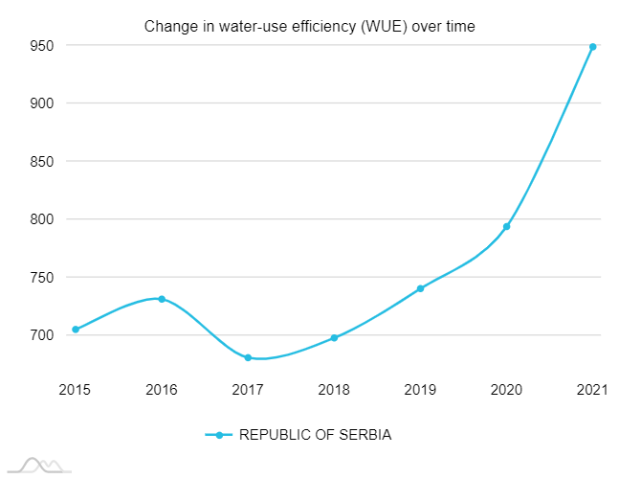
SDG 6. Ensure availability and sustainable management of water and sanitation for all:
*Republic of Serbia faces several challenges in achieving SDG 6, including the need for improved water management, infrastructure development, and water quality monitoring.
* Especially in rural areas.

Slide 10
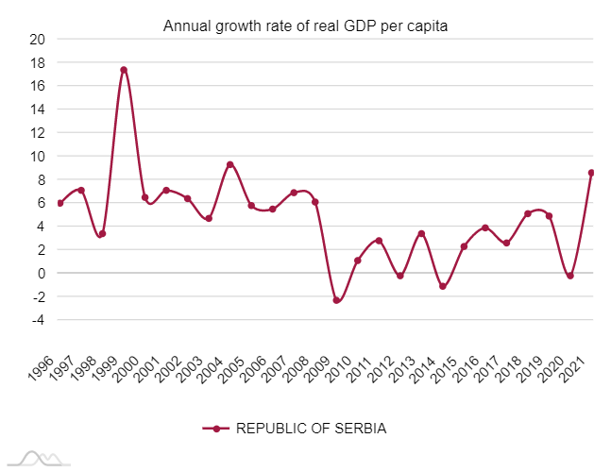
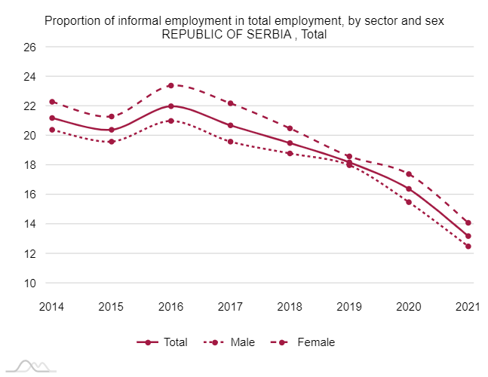
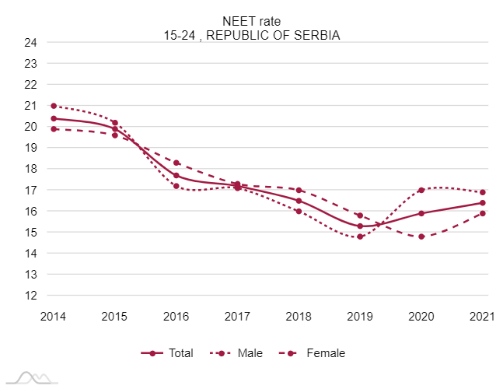
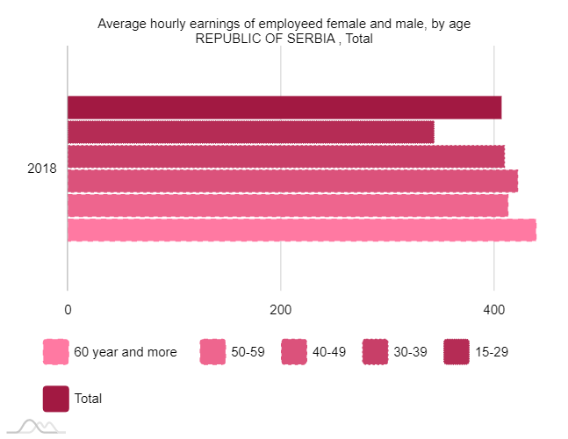
SDG 8. Decent work and economic growth:
the per capita economic growth was below the stated 7 per cent until 2021.
The NEET rate recorded a decrease until the coronavirus pandemic, after which it slightly increased, which is an unfavorable trend.

Slide 11
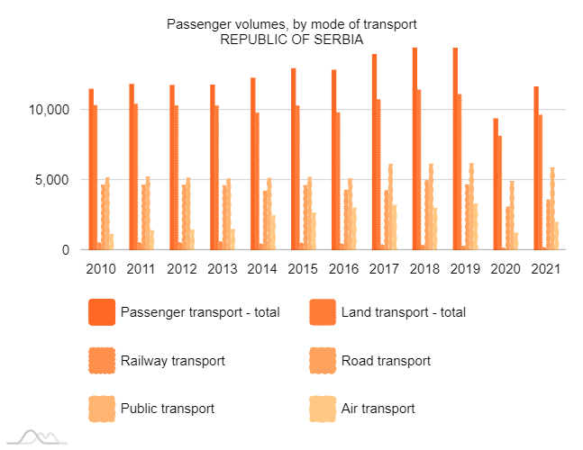
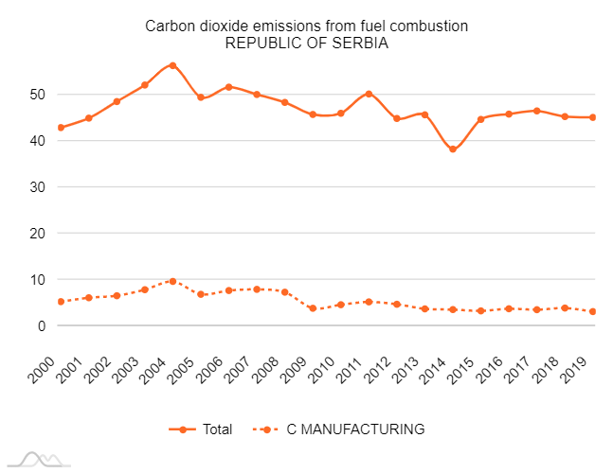
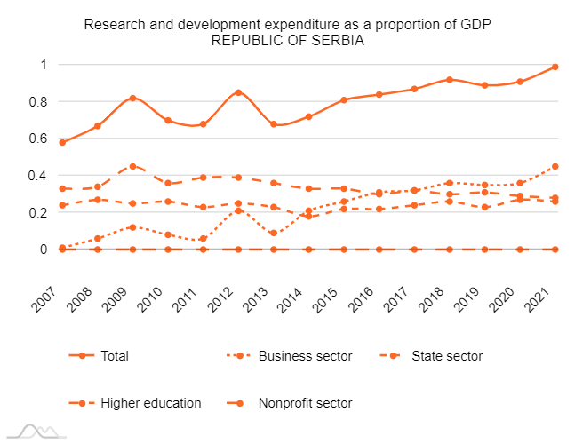
SDG 9. Build resilient infrastructure, promote inclusive and sustainable industrialization and foster innovation:
Regarding the mode of transport, land transport dominates the air transport, while concerning land transport road transport is more common compared to railway transport.
Manufacturing value added as proportion of GDP is slightly below EU average (which is 14.73%).
Regarding CO2 emissions Republic of Serbia is not on track with the percentage of CO2 emissions from fuel consumption being more than 40%.

Slide 12
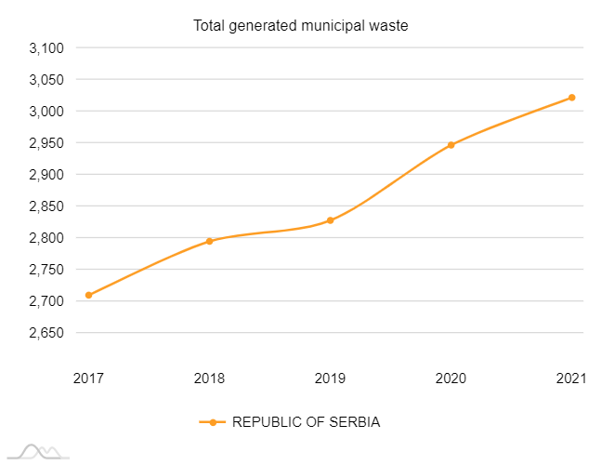
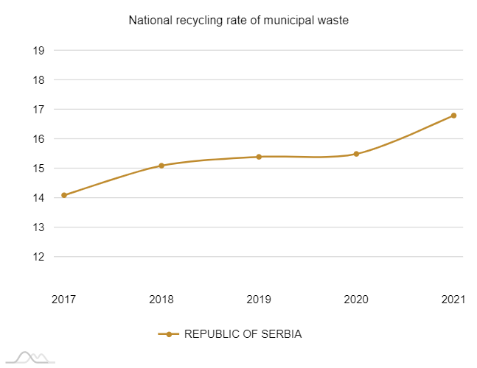
SDG 11. Make cities and human settlements inclusive, safe, resilient and sustainable
SDG 12. Ensure sustainable consumption and production patterns

Slide 13
Conclusion
Sustainable development is crucial for the EU's long-term prosperity, competitiveness, and quality of life. The EU has demonstrated its commitment to sustainable development by adopting a comprehensive approach that balances economic, social, and environmental factors.
By continuing to prioritize sustainable development, the EU can ensure a prosperous and sustainable future for its citizens and contribute to global efforts to address pressing environmental and social challenges.
On the other hand, Serbian progress toward sustainable development showed that there are still not adequately developed planning documents in terms of SDGs and defined clusters.
Moreover, grouping criterion of SDGs according to Agenda 2030 or negotiation clusters leads to sustainable development in both ways.
Lastly, Serbian progression toward sustainable development is visible and there are still numerous areas for improvement.

Slide 14
This research is part of the 101059994 – UR-DATA - HORIZON-WIDERA-2021-ACCESS-02 project, funded by the European Union. Views and opinions expressed are however those of the authors only and do not necessarily reflect those of the European Union or the European Research Executive Agency. Neither the European Union nor the European Research Executive Agency can be held responsible for them.

Slide 15
15th International Conference Economies of the Balkan and Eastern European Countries ΕΒΕΕC 2023
May 12-14, 2023
Chios, Greece
ADVANCING SUSTAINABLE DEVELOPMENT IN THE REPUBLIC OF SERBIA: CHALLENGES AND OPPORTUNITIES
Authors: Jelena J. Stanković, Ivana Marjanović, Sandra Milanović*, Milica Jovanović Vujatović, Marina Stanojević
Faculty of Economics, University of Niš, Trg kralja Aleksandra Ujedinitelja 11, 18000 Niš, Serbia
*sandra.milanovic@eknfak.ni.ac.rs

